Slide 1
Malmquist Bias and Photometry of Spirals
First Reader: Katryna Fast
Second Reader: Jordan Lasuik

Slide 2
Malmquist Bias
The method for determining the luminosity function is counting the number of objects that have a range of apparent magnitudes (m + dm, m) that lie within a certain region of the sky.
This function does not allow one to determine A(m) to arbitrarily faint magnitudes
Thus there is a limiting magnitude m₁ so A(m) is only defined by:
A(m) = A(m <m₁)
3.22
Information taken from Binney and Merrifield “Galactic Astronomy” 1998

Slide 3
Malmquist Bias (Cont.)
The Malmquist bias can be observed through taking a magnitude limited sample of the sky.
A magnitude limited sample contains only objects in a certain region of the sky with apparent magnitude greater than m₁.
From this sample, it can be seen that the mean absolute magnitudes will be greater than the mean absolute magnitudes for the total population.
This is directly caused by the volume with which we can see the most luminous objects compared to that with which we can see the faintest objects.
Information taken from Binney and Merrifield “Galactic Astronomy” 1998

Slide 4
Malmquist bias (Cont.)
The Malmquist bias is deducted based off the following assumptions:
No interstellar absorption
Luminosity function independent of distance
For a given area on the celestial sphere, the spatial density only depends on distance
There is completeness to apparent magnitude limit
Stars are of all of the same spectral type
Information taken from Butkevich, Berdyugin & Teerikorpi, “Statistical biases in stellar astronomy” 2005.

Slide 5
Malmquist Bias (Cont.)
There are five equations used to describe the Malmquist bias:
1) Magnitude-limited bias
2) Distance-limited bias
3)Gaussian luminosity
4) Integral bias
5) Unification
Information taken from Butkevich, Berdyugin & Teerikorpi, “Statistical biases in stellar astronomy”

Slide 6
Designations of Spiral Galaxies
S0 and SB0
Lenticular Galaxies
Smooth central brightness condensation
Transition between elliptical and spiral galaxies
Sa and SBa
Early type spirals
Conspicuous bulges and tightly wound smooth arms
Sb and SBb
Small central brightness condensations
Loosely wound, highly resolved arms
Sc and SBc
Spiral arms become less resolved
Less luminous on average than Sb and Sa galaxies.
Information taken from Binney & Merrifield “Galactic Astronomy” 1998; Sparke & Gallagher “Galaxies in the Universe” 2nd ed. 2007.

Slide 7
Hubble’s Tuning Fork Diagram
NASA & ESA. Retrieved from
https://www.spacetelescope.org/images/heic9902o/
Jan 30 2017

Slide 8
An Alternate Hubble Diagram
Retrieved from Sparke & Gallagher
“Galaxies in the Universe” 2nd ed. p. 38

Slide 9
Photometry of Spiral Galaxies
Most light emitted from galaxies lies in the infrared, which also tends to correspond with old, cold, red stars.
Young, hot, blue stars tend to emit in UV
These blue stars thus emit photons which are easily absorbed by the dust within galaxies.
These photons are later re-emitted in the far-infrared.
Optical data tends to show more dust than other ranges on the spectrum.
Information taken from Sparke & Gallagher “Galaxies in the Universe” 2nd ed. 2007

Slide 10
Photometry of spiral galaxies (cont.)
In infrared, the spiral arms appear smooth, while in UV they are more fragmented and detailed.
The ultraviolet
characteristics
are exemplified
in Sparke and
Gallagher
Figure 5.10
Image taken from Sparke & Gallagher
“Galaxies in the Universe” 2nd ed. p. 205
Information taken from Sparke & Gallagher “Galaxies in the Universe” 2nd ed. 2007

Slide 11
Photometry of Spiral Galaxies (cont.)
If galaxies were only comprised of stars, the angle from which they were observed would not matter as stars emit isotropically
However, dust within galaxies absorbs and re-emits photons, thus making the angle they are viewed on significant.
A galaxy seen face-on will be more luminous than if it were seen edge-on
The total magnitude of a galaxy is often stated as an face-on correction
Information taken from Sparke & Gallagher “Galaxies in the Universe” 2nd ed. 2007

Slide 12
Surface Brightness of Spiral Galaxies
Surface brightness can be approximated over features, such as spiral arms, for example, of a disk galaxy.
When this is done, the surface brightness is calculated as:
The exponential part of the above equation tends to end abruptly at a certain value R = R_{max}.
Beyond R_{max}, I(R) sharply decreases, but this is not the edge of the galaxy, as stars and HI gas are still found beyond R_{max}.
Information taken from Sparke & Gallagher “Galaxies in the Universe” 2nd ed. 2007

Slide 13
Surface Brightness of Edge-on Spirals
In an edge-on galaxy, I(R) becomes approximately
above and below the dust lane
Where R is measured along the major axis and z is the distance from the midplane.
Information taken from Sparke & Gallagher “Galaxies in the Universe” 2nd ed. 2007

Slide 14
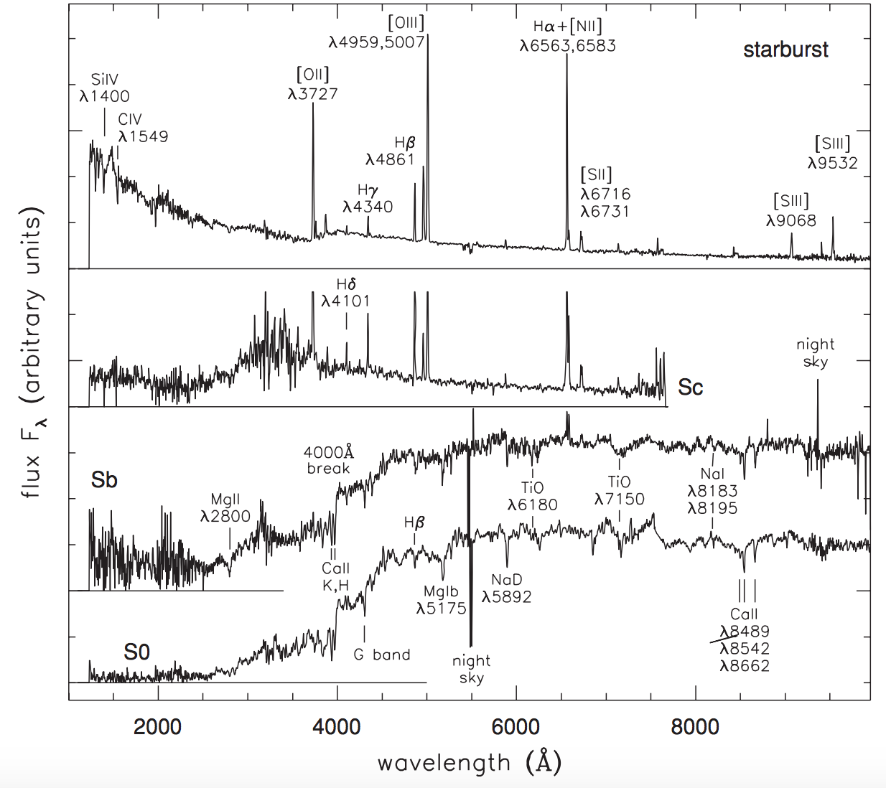
Image retrieved from Sparke & Gallagher “Galaxies in the Universe” 2nd ed. p.224

Slide 15
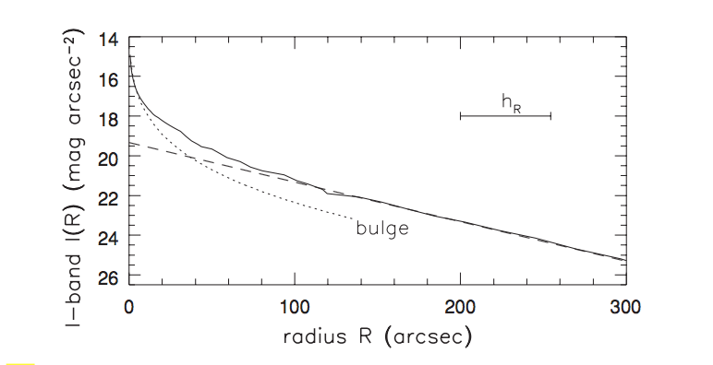
Image: I band surface brightness plot of galaxy 7331
Image retrieved from Sparke & Gallagher “Galaxies in the Universe” 2nd ed. p.198

Slide 16
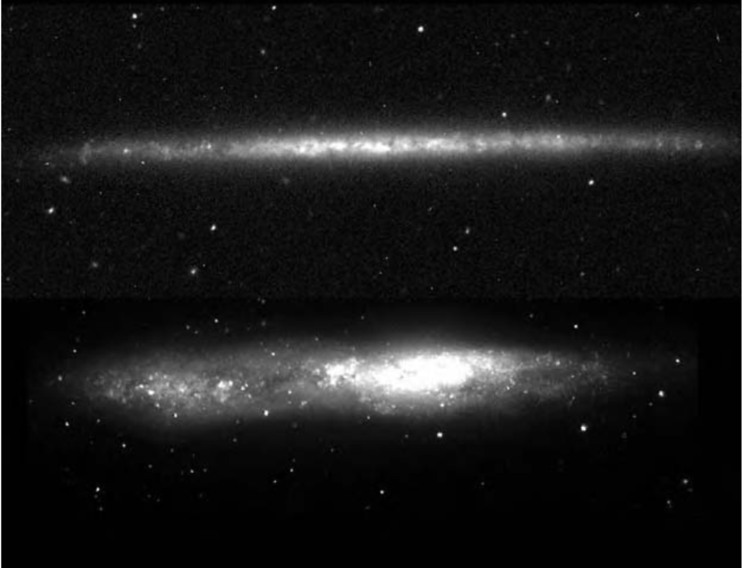
Bulges In Spiral Galaxies
The bulges for disk galaxies are greatly varied.
They range from “superthin” to “thick and fluffy”
Image taken from Sparke & Gallagher “Galaxies in the Universe”2nd ed. p. 202
Information taken from Sparke & Gallagher “Galaxies in the Universe” 2nd ed. 2007

Slide 17
Bulges in Spiral Galaxies (cont.)
Sm and irregular galaxies tend to contain the thick, fluffy bulges
Some Sc and Sd galaxies are observed to have superthin bulges.
The fraction of the total luminosity from the bulge can be calculated by:
This is referred to as the bulge fraction.
Information taken from Binney & Merrifield “Galactic Astronomy” 1998; Sparke & Gallagher “Galaxies in the Universe” 2nd ed. 2007.

Slide 18
Bulges in Spiral Galaxies (cont.)
B/T is related to the disk-to-bulge ratio D/B
B/T is confined to the integral (0,1)
B/T is closely correlated with the Hubble type.
Information taken from Binney and Merrifield “Galactic Astronomy” 1998

Slide 19
Spiral Structure
Grand-design
Two grand spiral arms
~10% of spirals
Caused by rotating bar or tidal interactions with other galaxies
“Ratty” or “Flocculent”
Loosely clumped texture
More common than grand-design spirals
“less photogenic”
Caused by ephemeral gravitational instabilities in the disk
Information taken from Binney and Merrifield “Galactic Astronomy” 1998

Slide 20
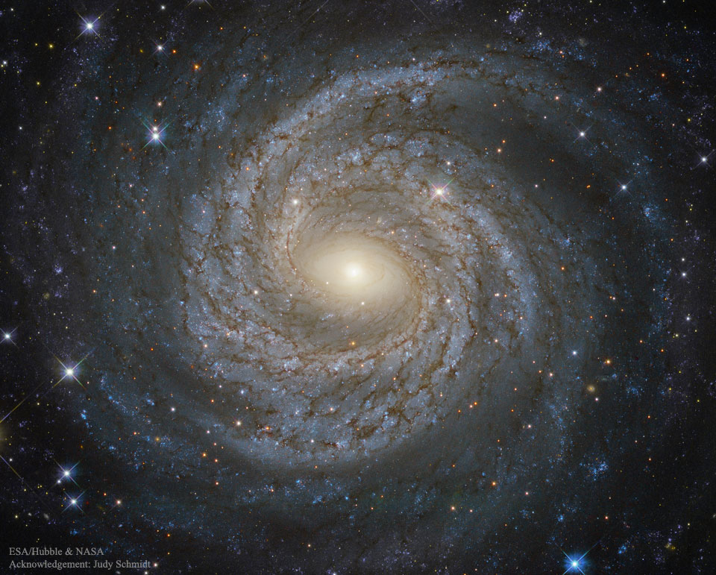
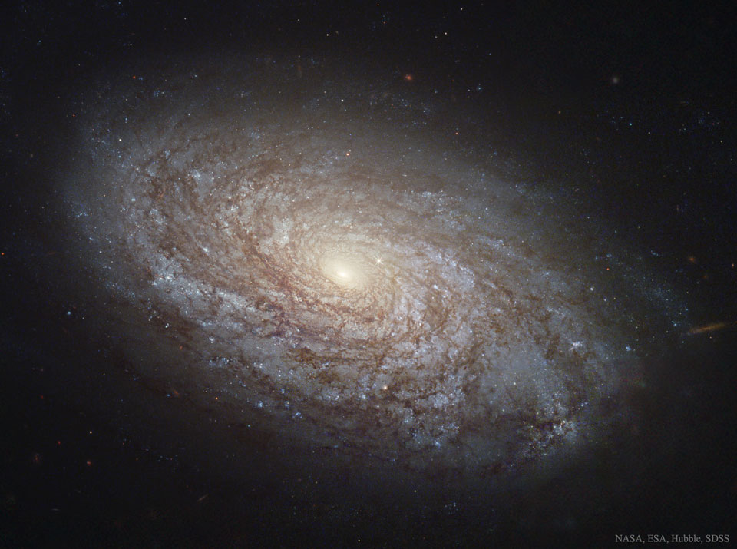
Grand design spiral example
NGC 6814
Image retrieved from APOD Feb 1 2017:
https://apod.nasa.gov/apod/ap160621.html
Flocculent galaxy example
NGC 4414
Image retrieved from APOD Feb 1 2017:
https://apod.nasa.gov/apod/ap161120.html

Slide 21
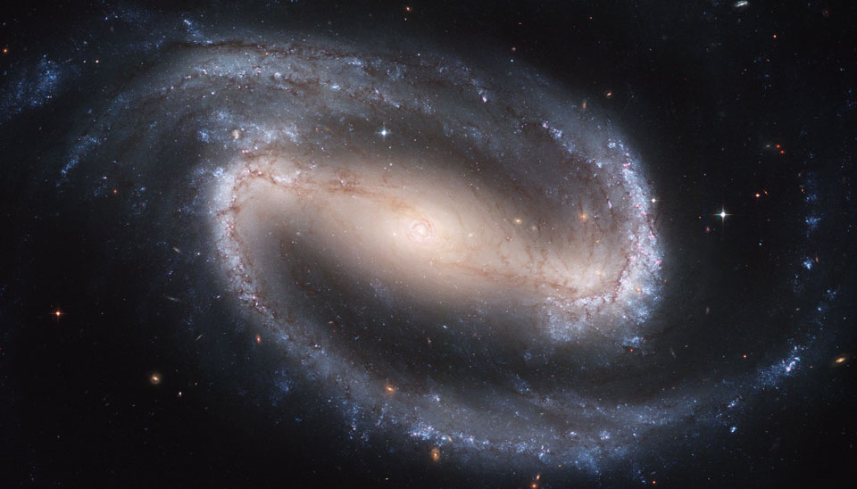
Spiral Structure (cont.)
Barred
The bars are elliptically shaped
Often contain rings or lenses
Often lopsided – the bar and bulge not necessarily at the center of the galaxy’s light distribution
Barred spiral galaxy example
NGC 1300
Image retrieved from APOD Feb 1 2017:
https://apod.nasa.gov/apod/ap160109.html
Information taken from Binney and Merrifield “Galactic Astronomy” 1998

Slide 22
References
Sparke, L.S. & Gallagher, J.S. (2007). Galaxies in the universe: an introduction (2nd ed.). New York, USA: Cambridge University Press. 27-41, 192, 198-206
Binney, J. & Merrifield, M. (1998). Galactic Astronomy. Princeton, NJ: Princeton University Press. 111-115, 149-157, 211-212, 214-222, 224-235.
NASA & ESA (October 1999). The hubble tuning fork – classifications of galaxies. Retrieved from https://www.spacetelescope.org/images/heic9902o/
Butkevich, A.G., Berdyugin, A.V., Teerikorpi, P. (2005). Statistical biases in stellar astronomy: the Malmquist bias revisited. MNRA 362, p. 321-330
NASA Astronomy Picture of the Day January 9 2016 https://apod.nasa.gov/apod/ap160109.html
NASA Astronomy Picture of the Day November 20 2016 https://apod.nasa.gov/apod/ap161120.html
NASA Astronomy Picture of the Day June 21 2016 https://apod.nasa.gov/apod/ap160621.html

