Slide 1
Stars & astronomy review
Keagan Blanchette

Slide 2
outline
Radiation
Distance
Blackbody
Stellar Spectra
The Lives of Stars
Stellar photometry
Color Indices & Band Pass Filters
Galactic coordinates
Galaxy Classification

Slide 3
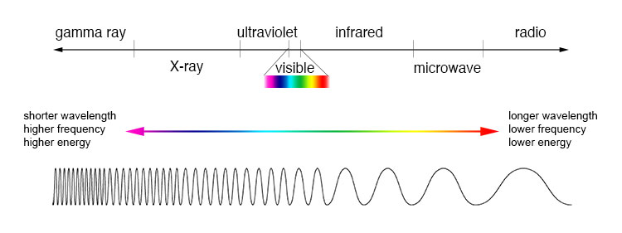
Radiation
All of the information we have about the universe comes from observing their light. Mainly, we observe in the UV, visible, and the IR.
The amount of light and the wavelength of the light coming from a star depends largely on its surface area, temperature, and its chemical composition.
The luminosity of a star is a measure of the amount of energy it outputs per seconds, and the SI unit for luminosity is Watts, although it is more commonly measured in ergs per second, since astronomers tend to use c.g.s. units.
The apparent brightness or flux is the total energy received per second on each square meter (or square cm) of the observer’s telescope, with units of W m⁻² or ergs s⁻¹ cm⁻².

Slide 4
radiation
Since stars shine with equal brightness in all directions, we can use the inverse-square law to find its luminosity L from the distance d and the measured flux F.
$F=\frac{L}{4πd^{2}} (1.1)$
The Sun’s total or bolometric luminosity is $L_{⨀}=3.86×{10}^{26}W=3.86×{10}^{33}erg⋅s^{−1}$.
Stars can differ greatly in their luminosity, with the brightest stars being over a million times more luminous than the sun, and the faintest we measure being ${10}^{−4}L_{⊙}$.

Slide 5
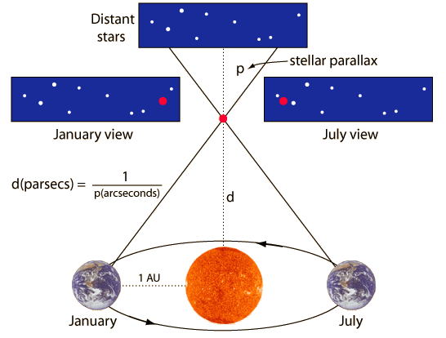
Distance
Typically, lengths in astronomy are measured using the small-angle formula. If for example we have two binary stars at a distance d from us which appear to be separated on the sky by the angle α, the distance D between the stars is given by
$α\left(rad\right)= \frac{D}{d} (1.2)$
Α is usually measured in arcseconds. 1” is 1/60 of an arcminute (1’) which is 1/60 of a degree.
Length is often given in terms of astronomical units. 1 AU is defined as the Earth’s mean radius, which is about 150 million kilometers.
Length is also often given in parsecs. A parsec is defined so that when D = 1 AU and α = 1”, d = 1 pc = 3.09 x 10²³ km = 3.26 light-years.
If we know the distance between two orbiting stars, we can use their orbital radius along with the speed they’re orbiting each other to measure their masses.

Slide 6
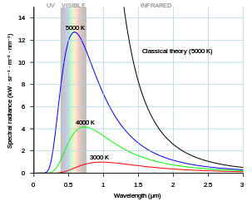
blackbody
Stars are dense balls of hot gas, whose spectrums are well approximated by that of a blackbody, with a temperature ranging from just below 3000 K up to 100,000 K.
The spectra of stars are modified by the absorption and emission of atoms and molecules in the star’s outer layers.
A blackbody is an ideal radiator or perfect absorber.
At temperature T, the luminosity L of a blackbody of radius R is given by the Stefan-Boltzmann equation.
$L=4πR^{2}σ_{SB}T^{4} (1.3)$
σ_{SB} = 5.67 x 10⁻⁸ W m⁻² K⁻⁴ and is known as the Stefan-Boltzmann constant.
For a star of luminosity L and radius R we define an effective temperature T_{eff} as the temperature of a blackbody with the same radius, which emits the same total energy.
The Sun’s effective temperature is $T_{eff}≈5780 K$.

Slide 7
blackbody
Generally, not all of the light emitted from a star is measured, but only what arrives at the telescope in a given interval of wavelength or frequency.
The flux per unit wavelength F_{λ} is defined by setting F_{λ}(λ)Δλ to be the energy of the light received between wavelengths λ and λ + Δλ.
The apparent brightness F is the integral over all wavelengths or frequencies.
$F≡\int_{0}^{∞}{F_{λ}\left(λ\right)dλ}=\int_{0}^{∞}{F_{υ}\left(υ\right)dυ} (1.4)$
At temperature T, the peak of F_{λ} occurs at wavelength:
$λ_{max}=\left[\frac{2.9}{T(K)}\right]mm (1.5)$
For the sun, this corresponds to yellow light, at approximately 5000 Å.
For people, uncooled parts of a telescope, and the Earth’s atmosphere all radiate mainly in the infrared, at about 10 μm.

Slide 8
Stellar spectra
The hottest stars are the bluest, and their spectra show absorption lines of highly ionized atoms.
Cool stars emit most of their light at red or infrared wavelengths, and have absorption lines of neutral atoms or molecules.
In the nineteenth century, astronomers classified stars according to the strength of the Balmer lines of neutral hydrogen HI, with A stars having the strongest lines, followed by B, then C, etc.
In the 1880s, it was realized that when the classes were arranged in the order O B A F G K M, the strengths of all of the spectral lines, not just those of hydrogen, changed continuously along the sequence.
It is now known that this spectral sequence lists the stars in order of decreasing surface temperature.

Slide 9
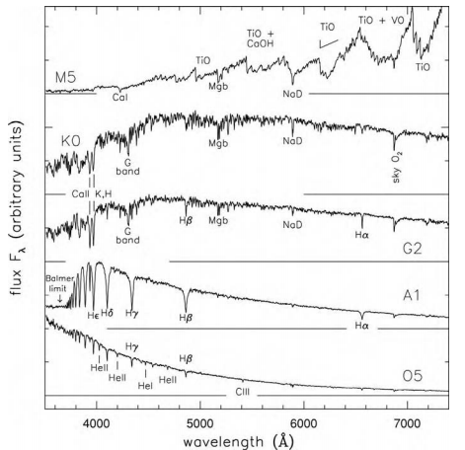
Stellar spectra
Each of the classes has now been subdivided into subclasses, from 0, which is the hottest, to 9, the coolest.
The Sun is a G2 star.
Recently classes L and T have been added to the system due to the discovery of very cool stars by infrared observers.
Stars at the beginning of this sequence are often referred to as early type stars, while those at the end are known as late type stars.

Slide 10
The lives of stars
Stars begin their lives as clouds of gas that become dense enough to start contracting under their own gravity.
Compression then heats the gas, increasing its pressure to support the weight of the exterior layers. But since the gas is now warm, it radiates away energy, reducing pressure, allowing the cloud to shrink further.
This is the protostellar stage, where the release of gravitational energy counterbalances that lost by radiation.
Temperature continues to rise throughout the protostellar stage until it reaches about 10⁷ K, when the star is hot enough to burn hydrogen into helium by thermonuclear fusion.
Nuclear reactions in the star’s core now supply enough energy to maintain the pressure at the center, and contraction stops.
The star is now stable and has begun its main-sequence life.

Slide 11
The lives of stars

Slide 12
The lives of stars
A star can continue on the main sequence until thermonuclear burning has consumed hydrogen in is core.
Massive stars have much shorter lives, and smaller stars have longer lives.
No star with a mass of < 0.8M_{ʘ} has ever left the main sequence since the Big Bang ~14 Gyr in the past.
At the end of its main sequence life, the star leaves the hatched area in the Hertzsprung-Russell diagram. Its life beyond that point is complex and depends highly on the stars mass.

Slide 13
Binary stars
Most stars are not found in isolation, rather they have a companion, or multiple companions. These are known as binary stars, or multiple star systems.

Slide 14
Stellar photometry
Typically, the apparent brightness of a star is given as an apparent magnitude. Originally, this was a measure of how much dimmer a star appeared to be compared to α Lyrae (Vega).
The brightest stars in the sky were of first magnitude, the next brightest were second magnitude, etc.
Increase in brightness means a decrease in apparent magnitude.
The apparent magnitudes m₁ and m₂ of two stars with measured fluxes F₁ and F₂ are related by
$m_{1}−m_{2}=−2.5\text{log}\left(\frac{F_{1}}{F_{2}}\right) (1.10)$
So if $m_{2}=m_{1}+1$, star 1 appears about 2.5 times brighter than star 2.
The magnitude scale is close to that of natural logarithms; a change of 0.1 magnitudes is equivalent to about a 10% difference in brightness.

Slide 15
Absolute magnitude
The absolute magnitude M of a source is defined as the apparent magnitude it would have at a standard distance of 10 pc.
If there is no dust or other obscuring matter between us and the star, we can use equation 1.1 to relate the measured apparent magnitude m and distance d to the absolute magnitude by
$m−M=−2.5\text{log}\left(\frac{f}{F}\right)=5\text{log}\left(\frac{d}{D}\right) (1.15)$
This can be corrected for if there is dust or some other obscuring matter by:
$m−M=5\text{log}d−5+A+K$, where A and K represent the correction for interstellar reddening and the correction for the redshift of the target respectively.

Slide 16
Color indices & bandpass filters
A filter bandpass is filter that measures the fraction of light that a star transmits at a given wavelength.
The “colour” of a star is defined as the difference between the amounts of light received in each of two bandpasses.
For apparent magnitudes, the bandpass in which the absolute magnitude of a star has been measured is indicated by a subscript.
The Sun has absolute magnitudes M_{B} = 5.48, M_{V} = 4.83, M_{K} = 3.31.
To find the total amount of energy coming from a star, we need to find its bolometric luminosity.
Since we cannot measure all of the light from a star, we use models of stellar atmospheres to find how much energy is emitted in the regions that we cannot observe directly.
Can then define a bolometric magnitude, given as
$M_{bol}=M_{V}−BC (1.16)$
Where BC is the bolometric correction, and varies between stars of different types.

Slide 17
Galactic coordinates
Similar to the way we can use latitude and longitude to specify the position of a place on earth, we can use Right Ascension and Declination to specify the positions of stars on the sky.
These two coordinates make up what is known as the equatorial coordinate system.
We imagine that the stars lie on a great sphere centered on Earth, known as the celestial sphere.
The celestial poles are then the points directly overhead at the Earth’s north and south poles.
The celestial equator is the great circle on the celestial sphere that runs directly above the Earth’s equator.

Slide 18
Galactic coordinates

Slide 19
Galactic coordinates
A star’s Declination δ, equivalent to latitude on Earth, is defined as the angle between its position on the celestial sphere, and the nearest point on the celestial equator.
An object at the north celestial pole has a declination of $δ={90}^{°}$, while an object at the south celestial pole has a declination of $δ={−90}^{°}$.
Throughout the year, the Sun appears to move slowly from west to east against the background of the stars. It lies to the north of the celestial equator in June and south of it in January. The great circle its path traces is known as the ecliptic.
The ecliptic intersects the celestial equator twice throughout the course of a year; at the vernal equinox in the spring, and at the autumnal equinox in fall.
A star’s Right Ascension α, equivalent to longitude on Earth, is measured eastward from the vernal equinox in hours, with 24 hours making up the complete circle.

Slide 20
Galactic coordinates
The direction of the Earth’s rotation axis changes slightly each year because of precession, therefore the celestial poles and equator do not stay fixed in the sky.
The vernal equinox moves westward along the ecliptic at a rate of approximately 50” per year.
Hence the α, δ of a star depend on which year we take as a reference for our coordinates.
Astronomers typically use coordinates relative to the 1950 or 2000 equinox, or the equinox of the current year.
These are easily converted between, and most common computer programs used are capable of doing this.

Slide 21
Galactic coordinates
To give the positions of stars as we see them in relation to the Milky Way, we use the Sun-centered system of Galactic latitude and longitude.
The center of the galaxy lies in the direction of α = 17^{h}42^{m}24^{s}, δ = -28˚55’ (equinox 1950).
Galactic longitude l is measured in the plane of the disk for the Sun-center line, which is defined as l = 0, towards the direction of the Sun’s rotation, l = 90˚.
The latitude b gives the angle of a star away from the plane of the disk.
b is measured positive toward the north Galactic pole at α = 12^{h}49^{m}, δ = 27˚24’ (1950).
The north Galactic pole is the pole of the disk that is visible from the Earth’s northern Hemisphere.

Slide 22
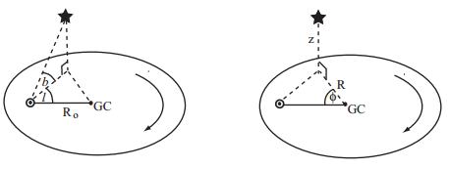
Galactic coordinates
To specify a star’s position in three-dimensional space, we can use a system of Galactocentric cylindrical polar coordinates R, φ, z.
R measures the distance from the Galactic center in the disk plane, the height from the midplane is given by z, with z > 0 being in the direction of the north Galactic pole, and the azimuthal angle φ measured from the direction towards the Sun, so that it is positive in the direction of l = 90˚.

Slide 23
Galaxy classification
The existence of other galaxies was only established in the 1920’s, before that they were known as nebulae, since they appeared fuzzy in telescopes and were not stars.
Hubble was the first to classify the different types of galaxies, and laid out his scheme in 1936, which is still in use today.
There were 3 main types of galaxy: Ellipticals, Lenticulars, and Spirals.
There was also a fourth class, Irregulars, which did not fit into any of the other categories.

Slide 24
Galaxy classification

Slide 25
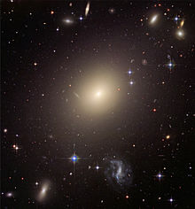
Galaxy classification
Elliptical galaxies are typically smooth, round, and almost featureless, and are lacking structures such as spiral arms and conspicuous dust lanes.
Ellipticals are generally lacking in cool gas and therefore have few young blue stars.
Normal or giant ellipticals have luminosities a few times that of the Milky Way, with characteristic sizes of tens of parsecs. The stars of these bright ellipticals show little organized motion, such as rotation, and their orbits around the galaxy center are oriented randomly.
In less luminous ellipticals, the stars have more rotation and less random motion.
ESO-325-G004

Slide 26
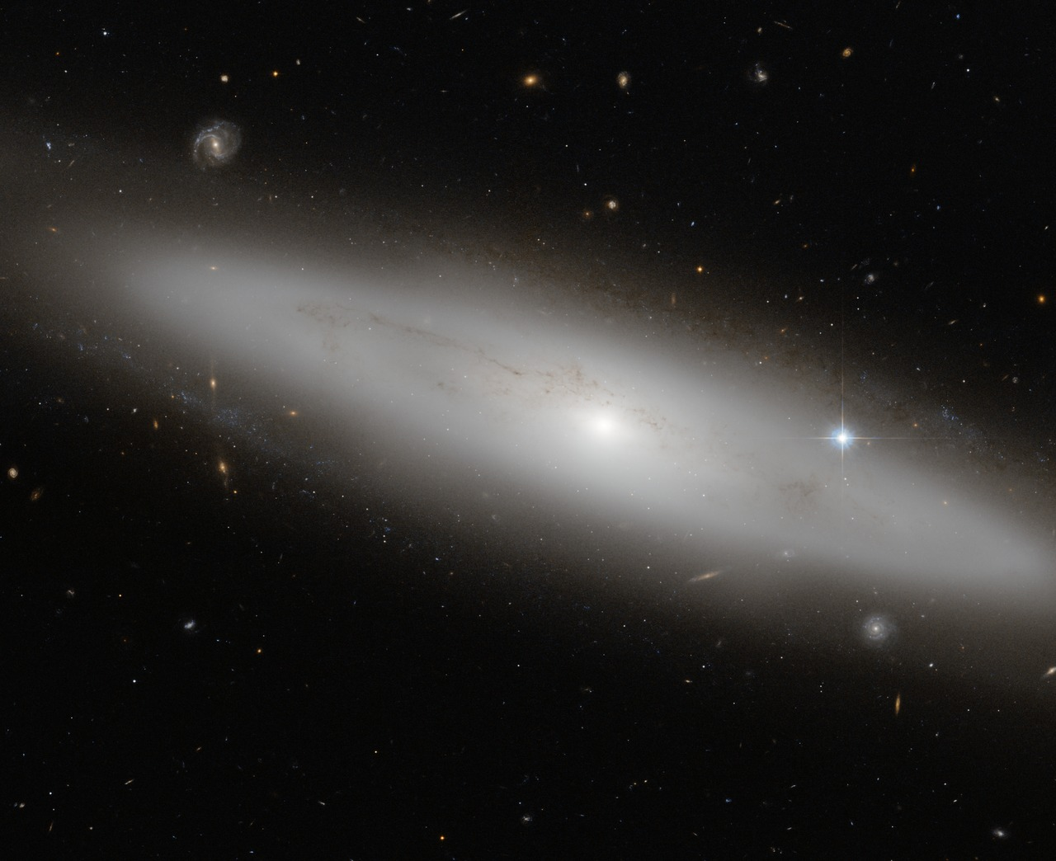
Galaxy classification
NGC 4866
Lenticular galaxies have a rotating disk along with a central elliptical bulge, however the disk lacks any spiral arms or extensive dust lanes.
A transition class between elliptical and spiral galaxies.
Resemble ellipticals in lacking extensive gas and dust, also have the thin and fast-rotating stellar disk.
Approximately haf contain a bar.

Slide 27
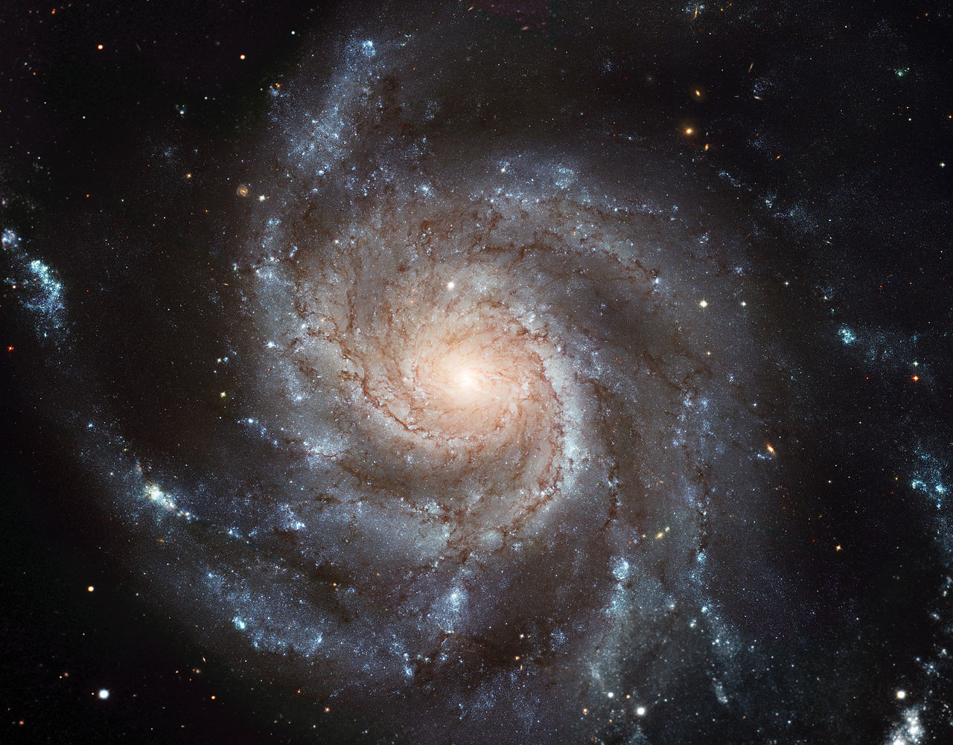
Galaxy classification
M101
Spiral galaxies take their name from their bright spiral arms.
These arms are outlined by clumps of bright and hot O and B stars, and the compressed dusty gas from which these stars form.
Approximately half of all spiral and lenticular galaxies show a central linear bar.
The barred systems SB0, Sba, ..., SBd, form a sequence parallel to that of the unbarred galaxies.
Along the sequence of spirals from Sa to Sd, the central bulge becomes less important relative to the rapidly rotating disk, while the spiral arms become more open and the fraction of gas and young stars in the disk decreases.
Our Milky Way galaxy is most likely an Sc galaxy, or perhaps an intermediate Sbc type.

Slide 28
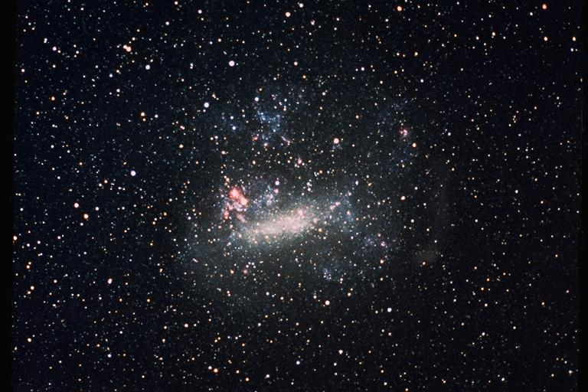
Galaxy classification
The Sm and SBm classes are Magellanic spirals, named after their prototype, which is our Large Magellanic Cloud.
In these, the spiral is often reduced to a single small arm.
As the galaxy luminosity decreases, so does the speed at which the disk rotates; Dimmer galaxies are more massive.
“Early type” and “Late type” galaxies are terms often used to describe the position of a galaxy along the sequence from elliptical galaxies S0s to Sa, Sb, and Sc spirals.

Slide 29
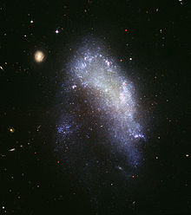
Galaxy classification
NGC 1427A
All other galaxies that do not fit into the other categories were originally placed in the Irregular class.
Today, the term is only used for small blue galaxies which lack any organized spiral or other structure.
Other galaxies that would have originally been classified as irregulars include starburst galaxies, and interacting galaxies.
Starburst galaxies are galaxies that have formed many stars in the recent past, and their disturbed appearance is due in part to the gas being thrown out by supernovae explosions.
Interacting galaxies are galaxies in which two or more systems have come near to each other, and galaxies that appear to be the result of a merger between two or more smaller systems.

Slide 30
Galaxy classification
A widely used expansion of the Hubble sequence is the De Vaucouleurs system.
The De Vaucouleurs system still divides galaxies into ellipticals, lenticulars, spirals, and irregulars, however it introduced a more elaborate classification system for spiral galaxies.
Galaxies are further divided based on whether or not they contain a bar, rings, or spiral arms.

Slide 31
Galaxy classification

Slide 32
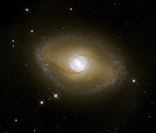
Galaxy classification
NGC 6872. Spiral glaxy – type SB(r)0/a

Slide 33
references
L. S. Sparke, J. S. Gallagher (2008). Galaxies in the Universe: An introduction (2nd Ed.). Cambridge University Press
Electromagnetic spectrum [Digital image]. (n.d.). Retrieved January 18, 2017, from https://imagine.gsfc.nasa.gov/Images/science/EM_spectrum_compare_level1_lg.jpg
Parallax [Digital image]. (n.d.). Retrieved January 18, 2017, from http://hyperphysics.phy-astr.gsu.edu/hbase/Astro/imgast/stelpar.gif
By Darth Kule - Own work, Public Domain, retrieved January 18, 2017, from https://commons.wikimedia.org/w/index.php?curid=10555337https://www.ifa.hawaii.edu/~barnes/ast110_06/tlos/gitu01_04.png
Fig. 1.2. L. S. Sparke, J. S. Gallagher (2008). Galaxies in the Universe: An introduction (2nd Ed.). – G. Jacoby et al., Spectral library
Fig. 1.4. L. S. Sparke, J. S. Gallagher (2008). Galaxies in the Universe: An introduction (2nd Ed.). – Geneva Observatory tracks
Fig. 1.9. L. S. Sparke, J. S. Gallagher (2008). Galaxies in the Universe: An introduction (2nd Ed.).
Fig. 10. L. S. Sparke, J. S. Gallagher (2008). Galaxies in the Universe: An introduction (2nd Ed.).

Slide 34
references
By The original uploader was Cosmo0 at English Wikipedia(Original text: None given) - Transferred from en.wikipedia to Commons., Public Domain, retrieved January 18, 2017, from https://commons.wikimedia.org/w/index.php?curid=3591173
By The original uploader was Clh288 at English Wikipedia - Transferred from en.wikipedia to Commons., Public Domain, retrieved January 18, 2017, from https://commons.wikimedia.org/w/index.php?curid=2512401
By NASA, ESA, and The Hubble Heritage Team (STScI/AURA); J. Blakeslee (Washington State University) - http://hubblesite.org/newscenter/archive/releases/2007/08/image/a/ ([image link http://imgsrc.hubblesite.org/hu/db/images/hs-2007-08-a-full_jpg.jpg]), Public Domain, retrieved January 19, 2017, from https://commons.wikimedia.org/w/index.php?curid=2109854
By NASA, ESA, and The Hubble Heritage Team (STScI/AURA) - http://www.spacetelescope.org/images/opo0624a/ (direct link)http://hubblesite.org/newscenter/archive/releases/2006/24/image/a (direct link), Public Domain, retrieved January 19, 2017, from https://commons.wikimedia.org/w/index.php?curid=5968476

Slide 35
references
By Credit:Image: European Space Agency & NASAAcknowledgements:Project Investigators for the original Hubble data: K.D. Kuntz (GSFC), F. Bresolin (University of Hawaii), J. Trauger (JPL), J. Mould (NOAO), and Y.-H. Chu (University of Illinois, Urbana)Image processing: Davide De Martin (ESA/Hubble)CFHT image: Canada-France-Hawaii Telescope/J.-C. Cuillandre/CoelumNOAO image: George Jacoby, Bruce Bohannan, Mark Hanna/NOAO/AURA/NSF - http://www.spacetelescope.org/news/html/heic0602.html ([cdn.spacetelescope.org/archives/images/screen/heic0602a.jpg direct link])See also: http://hubblesite.org/newscenter/newsdesk/archive/releases/2006/10/image/a, CC BY 3.0, https://commons.wikimedia.org/w/index.php?curid=36216331, retrieved January 18, 2017, from https://upload.wikimedia.org/wikipedia/commons/c/c5/M101_hires_STScI-PRC2006-10a.jpg
Public Domain, retrieved January 19, 2017, from https://commons.wikimedia.org/w/index.php?curid=57110
By Antonio Ciccolella / M. De Leo - https://en.wikipedia.org/wiki/File:Hubble-Vaucouleurs.png, CC BY 3.0, retrieved January 19, 2017, from https://commons.wikimedia.org/w/index.php?curid=50260841
Fig. 5.7, D. Mihalas, J. Binney, (1981). Galactic Astronomy: Structure and Kinematics of Galaxies
By The original uploader was Clh288 at English Wikipedia - Transferred from en.wikipedia to Commons., Public Domain, retrieved January 19, 2017, from https://commons.wikimedia.org/w/index.php?curid=2512401

