Slide 1
Phys 1810 General Astronomy Fall 2014
Bubble Nebula – NGC 7635
Professor Jayanne English
Labs: Mr. Ian Cameron -- start this week
A Survey of astronomical phenomena and objects.
Notes:
ALL THESE NOTES ARE COPYRIGHT JAYANNE ENGLISH.

Slide 2
Grab a syllabus
Online at
http://www.physics.umanitoba.ca/~english/2014fallphys1810/
Powerpoint lecture website is linked at above website
password is…
look at lectures in Notes Page mode to see extra information
note the recall column and summary areas for your notes.
Check syllabus for textbook and permitted calculators.
Volunteer as a notetaker ☺
Expectations:
Re-read class notes BEFORE coming to lecture.
Do specified readings BEFORE coming to class.
Office hours today at 3pm Allen 514
Notes:
Every one find the lectures? The material in the text?

Slide 3
Read BEFORE coming to class:
Celestial Sphere and angular measurements (Box 1-1)
Parallax 1.6, Box 1-2, 17.1.
Astronomical Unit (P.47)
Gravity 2.7
Tides 7.6
Note:
“Box” refers to the “More Precisely” boxed areas in the chapters.
A number like 1.6 refers to Chapter 1, section 1.6.

Slide 4
Scientific Method
Richard Feynman: Experiment is the sole judge of scientific “truth.”
→ based on facts.
Gottfried Wilhelm Von Leibniz: Truths of fact are contingent, and their opposite is possible.
→ Scientific “truth” is not absolute or perfect. Can change as more facts acquired.
Notes:
We can still have knowledge! Indeed scientists have a way of characterizing uncertainty.

Slide 5
Measurement & Error
Notes:
Some people dismiss science because it isn’t “absolute” --- it is true that science isn’t perfect and there are uncertainties. However this doesn’t mean that we don’t know.
Astronomers height vs weight; vs IQ… → trend vs scatter plot…. There is an uncertainty but we still can “know”. Do we need to measure every point to assess something? No…

Slide 6
Measurement & Error
Notes:
Astronomers height vs weight; vs IQ… → trend vs scatter plot…. There is an uncertainty but we still can “know”. Do we need to measure every point to assess something? No…

Slide 7
Measurement & Error
Notes:
Astronomers height vs weight; vs IQ… → trend vs scatter plot…. There is an uncertainty but we still can “know”. Do we need to measure every point to assess something? No…

Slide 8
Measurement & Error
Notes:
Astronomers height vs weight; … → trend. There is an uncertainty but we still can “know”. Do we need to measure every point to assess something? No…
This is a correlation – i.e. weight is correlated with height. This is also a “proportional to” relation – i.e. weight is proportional to height. If weight decreased as height increased, that would be an anti-correlation.

Slide 9
Measurement & Error
Notes:
Astronomers height vs weight; vs IQ… → trend vs scatter plot…. There is an uncertainty but we still can “know”. Do we need to measure every point to assess something? No…

Slide 10
Measurement & Error
Notes:
Astronomers height vs weight; vs IQ… → trend vs scatter plot…. There is no trend i.e. no correlation.

Slide 11
Critical Thinking:
Example: Jack is looking at but Anne is looking at George. Jack is married but George is not. Is a married person looking at an unmarried person?
Yes
No
Not enough information to decide
YES!
A scientific understanding cannot be dismissed because some details are unknown.
We do not need to measure every point in order to discern a trend.
Notes:
Do you have to know if Anne is married or not? No!

Slide 12
Scientific Method:
“Laws of Nature” defined as general rules that describe how nature works.
Evolution from one law to another, not a revolution. E.g. Newton’s Law of Gravitation is contained in Einstein’s General Theory of Relativity (GR).
Don’t be fooled by the word “theory”! GR is the more valid “law”.
Notes:
Laws are scientific hypotheses that survive testing by different types of experiments – they models of how nature works.
e.g. Newton’s Law of Gravitation works for bridges and planets in orbit but more experiments led to Einstein’s General
Theory of Relativity.

Slide 13
Vastness of the Universe
Example: If the galaxy is generously populated with technological civilizations like our own, how long would communication to the nearest one take?
-- 1 civilization per million stars
→ 5000 yr for 2-way communication.
Notes:
Compare that to lifetime of civilizations. How many messages would you expect?
We might have time to make our own calculation at the end of the term.

Slide 14
Special Distances: Small scales
Atoms & Light → Angstroms
eyes see wavelengths ~ 4000-7000 Å
sheet of paper ~ million Å thick,
10 Å = 1 nanometre
(m == metres)

Slide 15
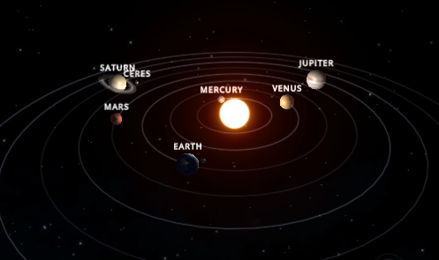
Special Distances: Solar System Scales
average distance between Earth & Sun
- called astronomical unit
written “1 AU”
i.e. about 150 billion metres
Notes:
The Earth really orbits in a slight ellipse. So the AU is really the average distance between the earth and the sun.

Slide 16
Special Distances: Star Scales
Light-year:
Written “ly”
distance travelled by light in 1 year
1 ly = 10 trillion km
(trillion = 1 with 12 zeros after it)
Lots of zeros ➔ Use Powers of Ten
Notes:
Nearest star ~ 4ly away. If it died today, when would be know about its death?
Ok we are now into huge numbers! Before talking more about distances, let’s look at how we can handle the large numbers.

Slide 17
Powers of Ten Notation
Scientific Notation
Count the number of zeros after the 1 and write it as a power of 10
For example:
Also 10=10**1
Notes:
A “power” is also called an “exponent”.

Slide 18
Powers of Ten Notation
Speed of light, c – measured.
(Practice: What is c in units of km/hr?)
Notes:
This is the speed of light in a vacuum.
Earth diameter = 13,000km = 1/20 light second

Slide 19
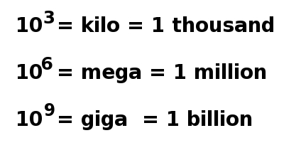
Powers of Ten Notation: common numbers in Astronomy
Count one number per second
16 min
2 weeks
50 years
Notes:
When it gets into days, it is count as 16 hours/day. This subtracts off 8 hours for sleep.
Also
trillion 10^12
quadrillion 10^15
goggle 10^100

Slide 20
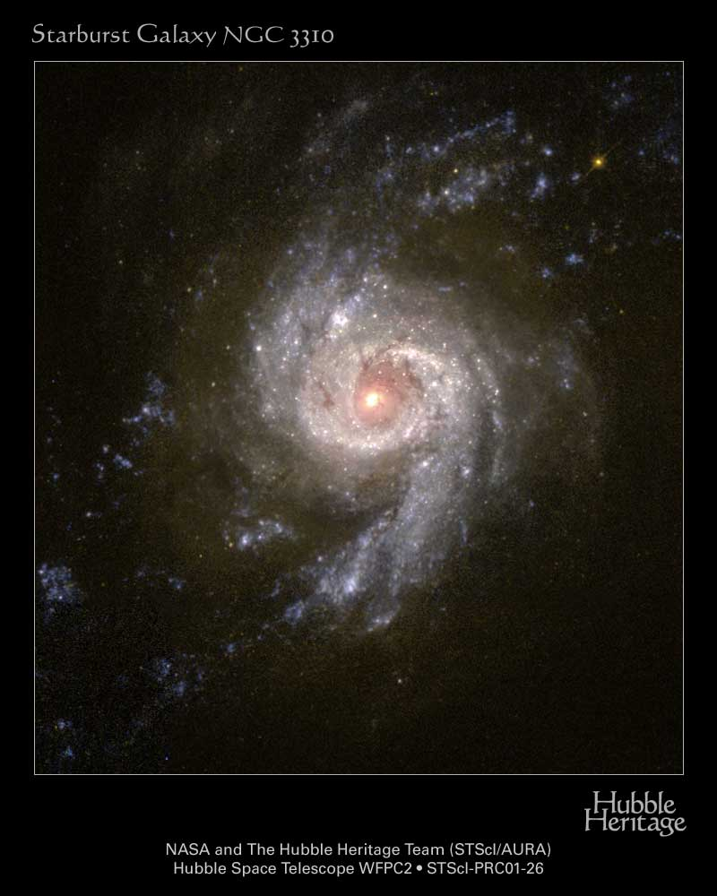
Powers of Ten Notation
100 billion stars
Notes:
A “power” is also called an “exponent”.
A galaxy has about 100 billion stars.

Slide 21
Powers of Ten Notation
Check supplemental website for handout under “powers of 10”
→ how to manipulate
Notes:
The link to the supplemental material is linked at the class website.
Check the Power of Ten listing for the formula sheet.

Slide 22
Powers of Ten Notation
Check supplemental website for handout under “powers of 10”
how to manipulate
Caution: No size limit to the universe but, due to limited c, there is size limit to the observable universe.
Notes:
The link to the supplemental material is linked at the class website.
Check the Power of Ten listing for the formula sheet.

Slide 23
Angstroms in Powers of Ten
(Practise: convert this to nm)

Slide 24
Convert light-years to metres

Slide 25
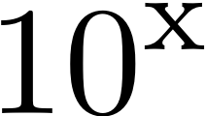
Powers of Ten Notation
We will work with orders of magnitude
Example:
Diameter of Sun = 109.13 * Diameter of Earth
Order of magnitude is 10**2 or 100.
(Powers can also be written as 10**x or 10^x)
Notes:
Using “x” for multiplication can get confusing so we’ll use another convention, “*”
More examples of order of magnitude as the class progresses.

Slide 26
Example Test Question
Movie by Ray and Charles Eames. Also check the class website.
The constellations would appear unfamiliar to those in the Earth’s sky if you could travel to
the nearest star (~4 ly)
the centre of our Milky Way Galaxy ( more than 55 thousand ly)

Slide 27
How do we know astronomical scales?
Notes:
Scales are sizes or lengths like dimensions of an object, the diameter of an orbit, or distance between objects.

Slide 28
Measurements on the Sky
All objects are at the same very large distance from the Earth such that they are projected on to an imaginary “celestial sphere”.

Slide 29
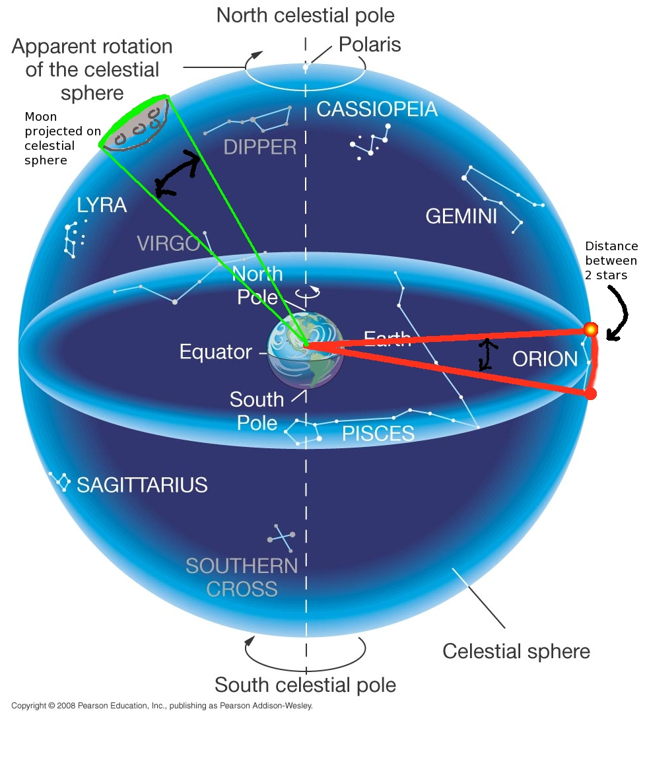
Measurements on the Celestial Sphere
Measurements are angular
Therefore use units of arc
Notes:
The celestial sphere is an extension of the surface of the earth at infinity. The distance between stars and the diameters of objects like the moon form arcs on a surface.

Slide 30
Measurements on the Sky
Angular units

Slide 31
Measurements on the Sky
Angular Size
Thumb at arm’s length ~ 2°
angular size of image?
Back of room room → smaller
The further away an object, the smaller the angular size
Notes:
What is the size at the back of the room? middle? front?
For comparison, the size of the moon on the sky is about ½ a degree.

Slide 32
Total Solar Eclipse
Check online for this copyrighted image.
http://antwrp.gsfc.nasa.gov/apod/ap090726.html
Copyright Koen van Gorp
Angular sizes misleading.
Because angular sizes are similar we see “atmosphere” of sun during an eclipse.
http://www.saros.org/ → animation
Notes:
Keyword google search: saros group eclipse
The eye adjusts to see faint light when the bright light from the sun’s surface (the photosphere) is blocked by the moon. We can then see prominences and the sun’s hot “halo” called the corona. Note how large the corona is compared to the sun! More about the components of the sun later in the course.
NOTE: IMAGES WITH COPYRIGHTS WILL BE REMOVED FROM THE LECTURE NOTES POSTED ON THE WEB
(lect3corona_vangorp.jpg)

Slide 33
Angular Measurement:
Given objects with the same linear size, this implies that if an object appears to have a smaller the angular size, then it is further away.
Notes:
Given objects with the same linear size, this implies that the smaller the angular size, the further away an object is.
This, and the example of the sun and moon having similar angular sizes, demonstrate that angular size can be misleading.
How do we know the actual size?

Slide 34
Linear Measurements
How do we go from angular measurements on the sky to knowing the linear diameters of planets, for example, or the distances between stars?
Distance
Geometry
Notes:
We use the distance to the object and simple geometry.

Slide 35
Linear Measurements: Geometry
Draw 2 imaginary circles
Circumference = 2 pi * Radius
Revolution = 360 degrees
The fraction of the outer circle covered by the diameter of the object is equal to the fraction of the inner circle covered by the angular diameter.
Notes:
Note that the orange object need not be in orbit around the blue object. The circle can be imaginary.
That is, if the object covers 1/10 of the outer circle, it also covers 1/10 of the inner circle.
Note * means “multiply”.

Slide 36
Linear Measurements: Geometry
Linear diameter angular diameter
--------------------- = -----------------------
2 pi * R 360 degrees
Notes:
Since the fractions are equal we can set these ratios equal to each other. i.e. diameter/circumference

Slide 37
Linear Measurements: Geometry
Notice that the radius of the outer circle is equal to the distance to the object:
Linear diameter angular diameter
--------------------- = -----------------------
2 pi * Distance 360 degrees
Notes:
Substitute in distance for radius!

Slide 38
Linear Measurements
The linear diameter is:
2 pi * Distance
linear diameter = --------------------- * angular diameter
360 degrees
Measure the angular diameter
Measure the distance
Put these in the equation
→ Gives the linear diameter!
Re-arrange the equation so the calculated parameter is on the left.
Notes:
Just re-arrange the equation. Make sure the angular diameter is in degrees rather than arcsec or arcmin.
In science we don’t have to listen to an authoritative person (e.g. priest, astrologer) – we are empowered by figuring it out by ourselves. Mathematics is the language and the tool.
Practice Example – in next class:
e.g. What is the linear diameter of the moon? Look up the distance in Astronomy Today or online in km. Go out and use your thumb to measure the number of degrees (– check this against the value I gave previously). And you have the moon’s diameter.
Then you can ask how big is the moon compared to the Earth by forming a ratio of diameters to calculate how many moon diameters equal 1 Earth diameter.

Slide 39
Distances
For 2: How we can get distances to objects in our solar system?
We can get the distances to the moon and other planets by bouncing radio waves off them, i.e. by using radar.
http://science.howstuffworks.com/radar2.htm

Slide 40
Distances
Radio waves, along with visible light, are part of electromagnetic spectrum
Light travels at specific speed, c.
c = 300,000 km/s roughly.
Speed = distance/time
so distance = speed * time
distance = c * time
where time is the time for radar signal to bounce back to Earth from object in solar system
Notes:
The speed of light is not a theoretical number. It has been measured since the 1600s and it is done yearly as an undergraduate lab experiment in this department. It is 299,792 km/s but 300,000 km/s will do for this course ☺
Speed -> think of what you know when you are driving your car.

