Slide 1
Phys 1810 General Astronomy Fall 2014
Bubble Nebula – NGC 7635
Professor Jayanne English
Labs: Mr. Ian Cameron -- start Monday
A Survey of astronomical phenomena and objects.
Notes:
ALL THESE NOTES ARE COPYRIGHT JAYANNE ENGLISH.

Slide 2
University Announcements
On Aurora:
update phone number
forward mail to your fav email address
Update to your “mymanitoba” email address.
Only use your UM email
Read about consequences of cheating and plagarism via links on the syllabus.

Slide 3
“Student Accessibility Services requires volunteer note-takers for this class. If you would like to volunteer, and receive a reference letter for your time, please login to JUMP and click on the Student Accessibility Services link on the right hand side of the page.
Volunteering is now easier than ever, you can upload notes directly to JUMP with the SAS scheduler. Thank you.”
Notes:
1 for each lecture section.

Slide 4
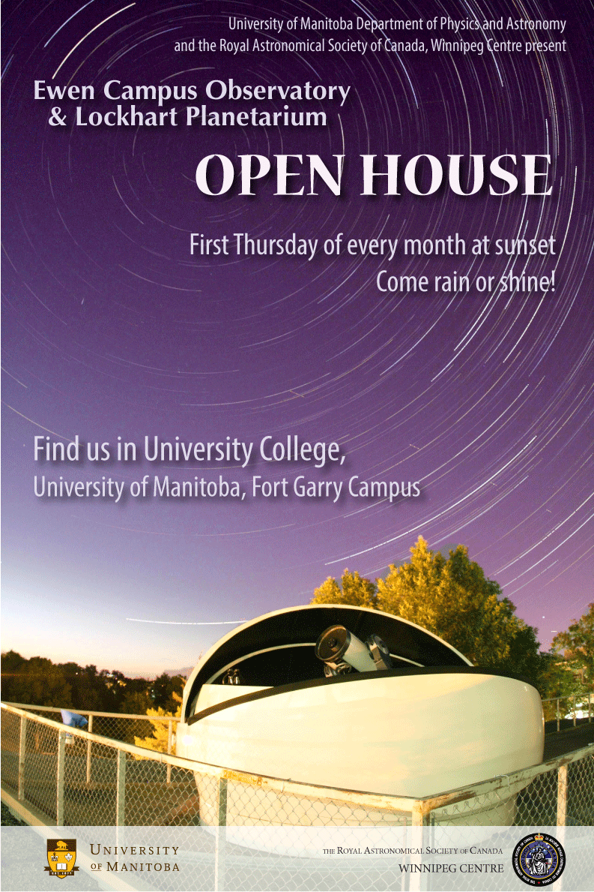
The first evening for public viewings is THIS THURSDAY Sept 4th. Please join us this week, and the first Thursday of every month, rain or shine. Friends and family are welcome too!
Link to more info:
http://umanitoba.ca/faculties/science/departments/physics/i

Slide 5
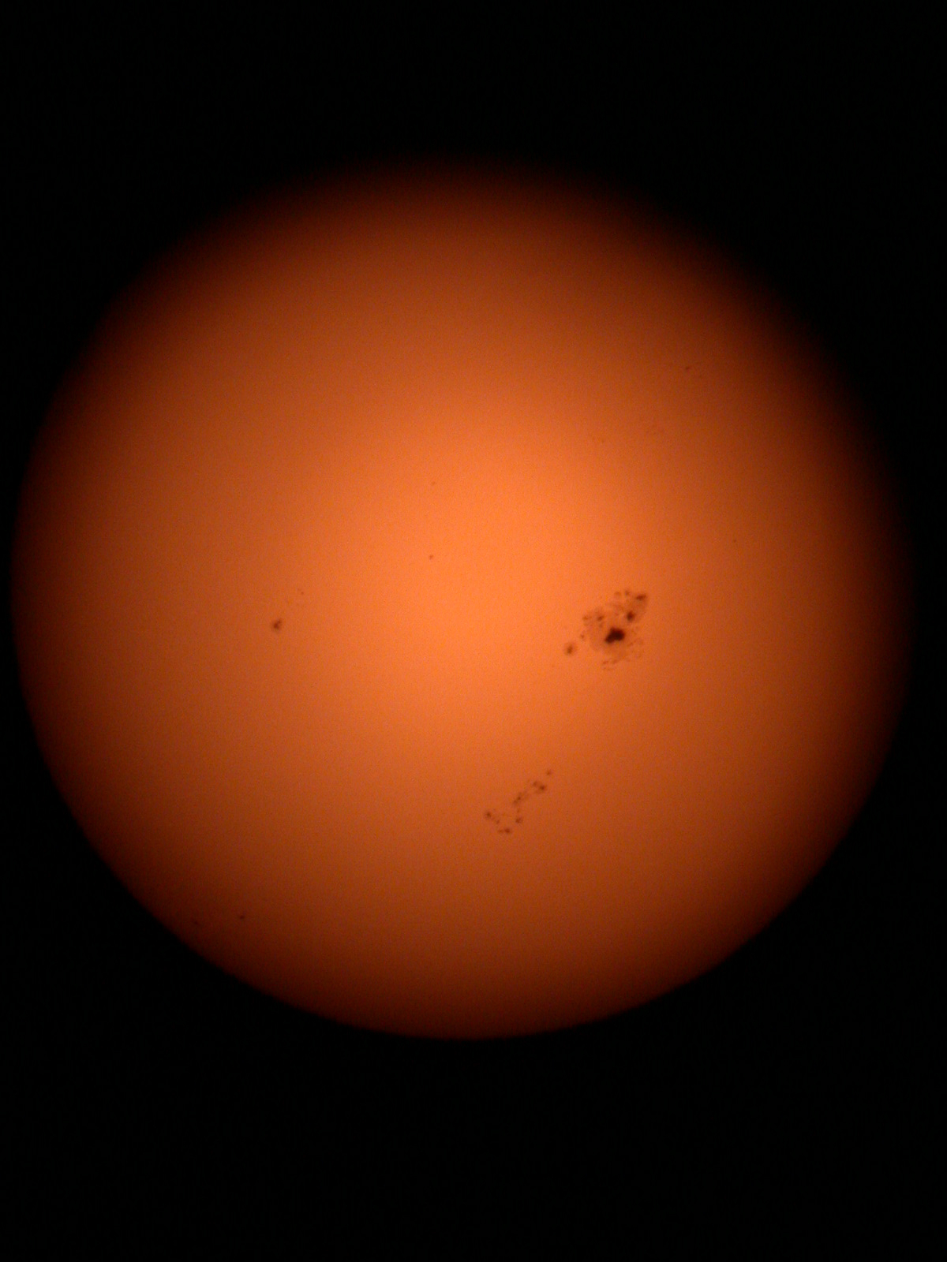
Astronomy Stream
Add/Drop date Sept 17
Phys 1830 – Winter 2015, 1:30 pm
Perspective on the Universe.
Qualitative, descriptive course. Basic arithmetic; no math requirement.
2. Phys 1810 – Fall 2014, 10:30am and 1:30pm
General Astronomy I. Helpful to have math requirement.
Overview of background, phenomena, planets through cosmology.
3. Phys 1820 – Winter 2015
General Astronomy II. Math requirement.
Highlights specific topics.
4. Phys 2070 – Full year on Tues & Thurs evenings
Observational Astronomy. Math requirement.
Hands-on. Uses Glenlea Observatory.
Both terms and in the evening.
Notes:
Are you in the course you want to be in? More room in the 1:30pm class.
There is a program for astronomy. Astrobio – can give you a list of appropriate courses.

Slide 6
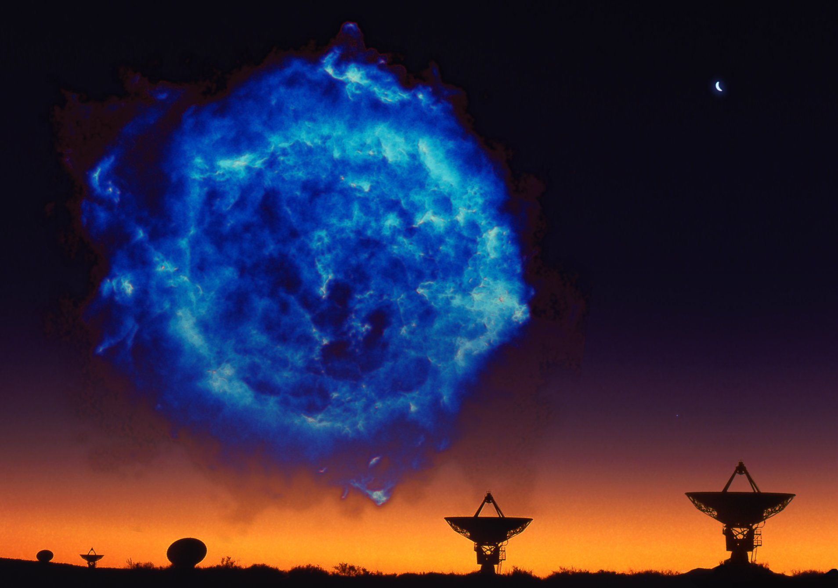
PHYS 1810
Textbook is Astronomy Today, 8th edition Chaisson & McMillian - check the library. Can be used for Phys 1810/20/30. If bought new, there is a website with lots of multiple choice questions for practise. Need a personal access code that comes with new book. Do not need a class access code.
Lectures are the primary material - textbook supplements lectures. Readings will be assigned in class to be read before attending the next lecture.
Material for the course is also on the class website maintained by Prof English. http://www.physics.umanitoba.ca/~english/2014fallphys1810/ Includes links to:
power points of lectures - password only given in class.
Supplemental material – used in class.
Study techniques e.g. for every 1 hr lecture, do 3 hrs prep and study.
Notes:
Reference text: won’t be working directly from it for the whole course.
Come to my office to give me feedback.
Dr. English’s Background:
Research astronomer/astrophysicist studying galaxies for 40% of my time. Briefly galaxies are collections of stars, gas, dust and dark matter.
Also an artist: graduated from the Ontario College of Art and Design.
Coordinated the Hubble Heritage Team for 2 years and continue to make images from HST data, as well as from other data.
I don’t know anything about the labs.
Mr. Cameron’s Background:
Provides technical and teaching support
Runs the planetarium and observatories – Astronomy Facilities Director
Astrophysics background

Slide 7
Syllabus Review
Grading:
70%: 1 midTerm test (Oct 22, 6pm) and 1 exam
30%: lab and observing projects
Lectures and Tests:
Up to 50% of material could be math – Office of Physics Undergraduate Students has tutors.
Images are as important as text.
Only specific non-programmable calculators allowed –read syllabus.
Missed Test:
Need a doctor’s note or coach much make arrangements with Dr. English.
Mark based on final exam.
Missed Exam:
Student checks with their Faculty about the possibility of writing a deferred exam.
Voluntary Withdrawal deadline: Nov 12th
Notes:
Syllabus will be updated online – please check continuously.
test so that you have marks before deciding to withdraw.
Exam on material in that section but need background from previous section
labs include planetarium and visit to observatory. Mr Cameron describes these.

Slide 8
Labs:
Start this week
Meet in the Lockhart Planetarium at University College for 2 weeks; joint with other astronomy class.
Mr Cameron will post the lab schedule.
experience of doing science.
labs do not follow the lectures but provide additional knowledge and experience.
hand in assignments and do the observing projects to pass the course. (Hand in log books.)
instead of doing homework (~3 hours every second week).

Slide 9
Learning Philosophy
Guideline for grades:
C-C+ is roughly 60-69% → average is about 65%
B-B+ is roughly 70-79% → good to very good
A is roughly 80-89% → excellent
A+ is > 90% → EXCEPTIONAL
The factor that correlates most closely with grades is attendance at lectures. Marks are based on material in lectures, not textbook.
1/3 of your mark is based on the lab work! Start on your observing project early.
Notes:
Grades:
C-C+ is average ➔ most people get around this grade.
A+ is really exceptional and it is rare. Hardwork memorizing won’t achieve this grade. Critical thinking will.
Especially as the term goes on the material will come more and more from the lectures.

Slide 10
Syllabus Review Continued
Office Hours:
Monday 3:00 pm
Allen 514
individually or as a Discussion Group
Email to make an appointment with Prof. English and with Mr. Cameron
Come visit if you have astronomy questions or ideas.
Questions about course and syllabus?
Notes:
You can come alone to my office or in groups.
Discussion group:
- can be used for study or discussion. E.g. bring images – could incorporate these into the class.
You can hold it without me if you like.
Date to be set up by those who are interested and I can book a room (e.g. can do it over coffee). First meeting on Monday at 3:30 pm.

Slide 11
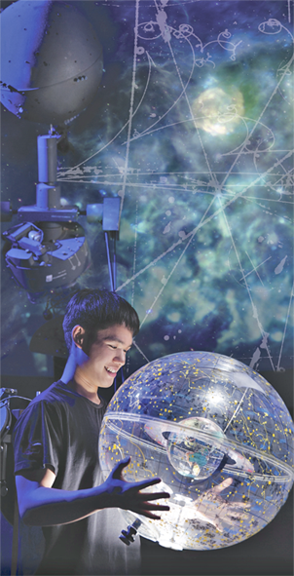
Phys 1810 Course Outline
Prof Jayanne English
A SURVEY OF THE UNIVERSE.
The universe is defined to be the totality of all space, time, matter, and energy.
Vastness of the Universe:
Arithmetic, Powers of Ten,
Scales, coordinates, distances, sizes
Constellations covered in the Lockhart Planetarium
Notes:
We’ll touch on “big ideas” through out. Access the scale interactive via the Supplemental Resources webpage for this class (linked on the class website http://www.physics.umanitoba.ca/~english/2014fallphys1810).

Slide 12
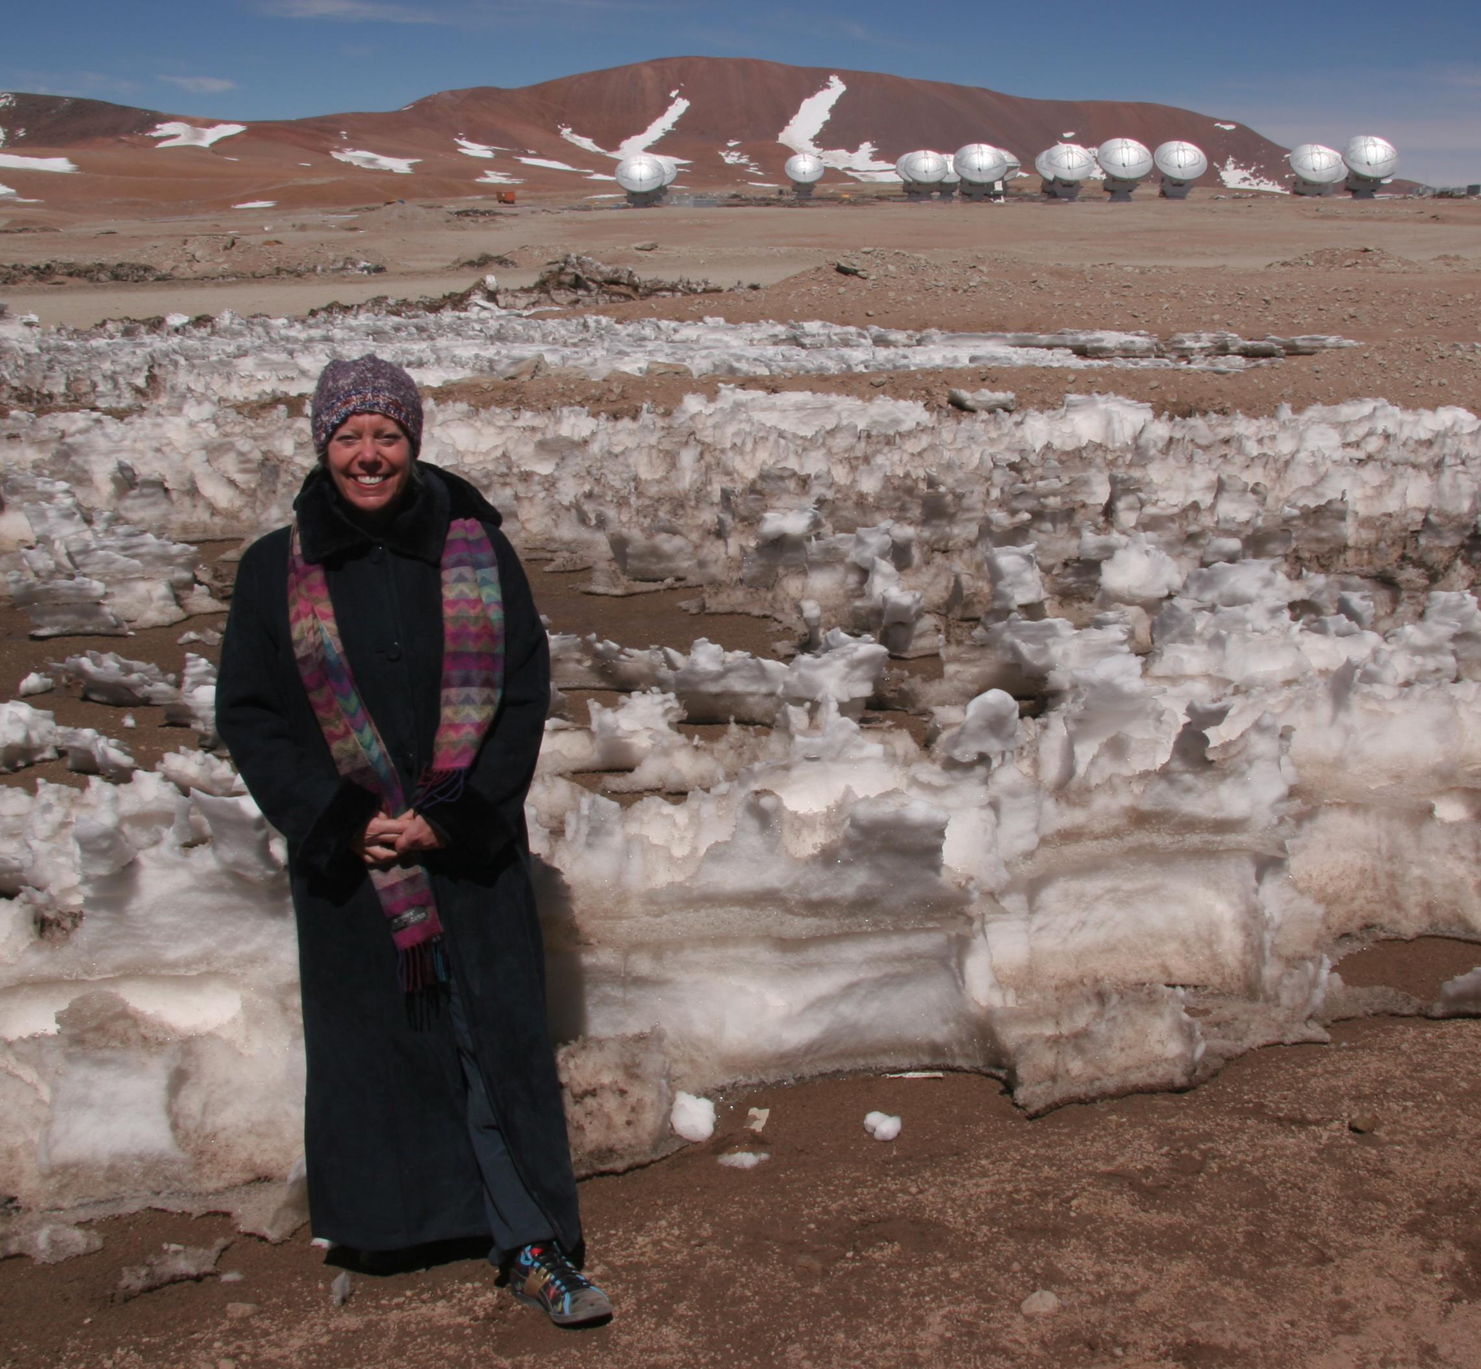
Phys 1810 Course Outline
2. Fundamentals of how we know what we know:
Light, electromagnetic radiation, motion, gravity
Telescopes & detectors, resolution
Brightness Law for distance to stars.
ALMA: Currently the most popular telescope with astronomers – the Atacama Large Millimetre/submillimetre Array, Chile.
Notes:
We’ll touch on “big ideas” through out, including General Relativity.
Demo of forces – gravity and EM. The demo was of Eddy Currents.

Slide 13
Phys 1810 Course Outline
3. Cosmic Topics:
Planets – our solar system and beyond
Stars – their birth and death, exotic stars
Black holes
Galaxies – our Milky Way and beyond
Cosmology – e.g. dark matter and dark energy (things we can’t see)
Saturn, backlit by the Sun (NASA, Cassini Spacecraft)
Notes:
Includes “big ideas” associated with these topics.
Let’s look at some of these topics – this powerpoint with images will be on the password protected website.

Slide 14
Jayanne English and A. Russ Taylor for CGPS
The Birth and Death of Stars
Notes:
Cygnus region of the Milky Way Galaxy. Supernova Remnants, star forming clouds, gas and dust.
Radio telescope and infrared image – nothing that you see with your eyes.

Slide 15
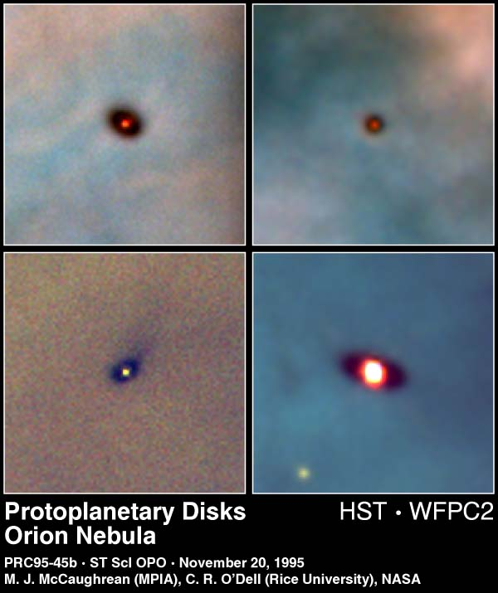
Star Birth
Planet Birth
Notes:
Eagle Nebula – stars form in the “finger tips” sticking out of the columns of gas.
Orion Nebula – around the stars are disks of gas & dust that the planets form out of.

Slide 16
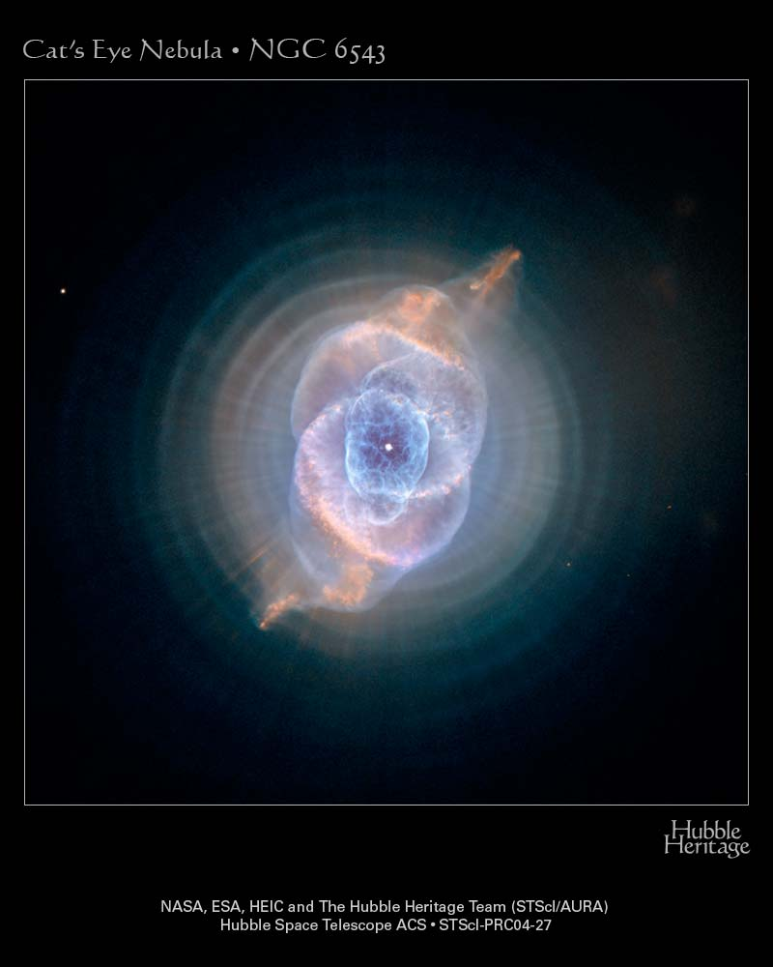
The Death of Stars like our Sun
Notes:
Planetary Nebula – dying star.

Slide 17
Galaxies
The habitats of stars, black holes, and dark matter.
Notes:
Edge-on Galaxy. Still a spiral galaxy.

Slide 18
Seyfert’s Sextet: Jayanne English, Chris Palma et al. (NASA’s HST)
Groups of Galaxies
Clusters of Galaxies
Notes:
Groups of galaxies – galaxies interact with each other
Clusters of galaxies – the arcs demonstrate the existence of Dark Matter

Slide 19
Cosmology – the accelerating expansion of the universe and Dark Energy
Notes:
Stare at apparent emptiness for long enough and you find that there are thousands of galaxies.
12 billion years of history is in this image.
Cosmology is the study of the universe as a whole.
Was the universe born? Will it die? What is the Big Bang?

Slide 20
Why study astronomy?
Learning some math and critical thinking skills.
David McConville:
“Throughout history, human civilizations have been guided by interpretations of the cosmic order.”
How one acts in the world depends on whether one thinks they are the centre of the universe or not. (not)
Notes:
McConville is the President of the Buckminster Fuller Institute.
Imagine yourself in a fog with a flashlight – you can see only to the end of the beam, but not the whole world. You might think you were at the centre of the world but you are not.

Slide 21
This Class
Scientific Method
Section 1.2 (p.8-9)
Material in this lecture & supplemental website
Read before coming to next couple of classes:
Speed of light (G-19, back cover)
Distances
light years Section 1.1 (p.6-7)
powers of 10
Appendix A and “handout” at website
Celestial Sphere and angular measurements (Box 1-1)
Parallax 1.6, Box 1-2, 17.1.
Astronomical Unit (P.47)
Gravity 2.7
Tides 7.6
The lectures will be on the powerpoint website – access through link on the classroom website.
Password is …
Notes:
Password will change a couple of times a term – e.g. after add/drop date and after VW date. Not usually given by email. Do not share – come to class to get it.

Slide 22
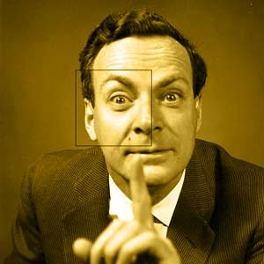
Scientific Method: Richard Feynman
Observation, reason, and experiment make up what we call the scientific method.
The principle of science, the definition, almost, is the following: The test of all knowledge is experiment. Experiment is the sole judge of scientific “truth.”
Notes:
This course is meant to be an introduction to science. Here are a couple of my favourite quotes describing science – they apply to astronomy and astrophysics.
Richard Feyman was a 20th century theoretician and Nobel prize laureate. He demonstrated at the hearings for the Challenger Shuttle Disaster how an O-ring could have broken by dropping it into a glass of ice water and demonstrating that it remained deformed. These quotes are from the Feynman lectures and the italics are his.

Slide 23
Scientific Method: Richard Feynman
News items ←
as perspective
changes.
Where do the laws that are to be tested come from? Experiment, itself, helps to produce these laws, in the sense that it gives us hints. But also needed is imagination to create from these hints the great generalizations - to guess at the wonderful, simple, but very strange patterns beneath them all, and then to experiment to check again whether we have made the right guess.
Notes:
In the text book the figure is in section 1.2.
Physics and astronomy both divide up the experimental and theoretical parts so we have observers and theorists.
Collect observations and/or all the facts from experiments (data)
Develop a theory to explain these data
Theory makes a prediction (If this holds, then that would hold too)
Collect observations to see if the prediction occurs
Revise the theory
Repeat
You can begin the process anywhere in this circle – often discoveries do not start with a theory.
Scientists agree to use this “guess and test” framework to test knowledge.

Slide 24
Scientific Method: Gottfried Wilhelm Von Leibniz
There are 2 kinds of truths; those of reasoning and those of fact.
Truths of reasoning are necessary, and their opposite is impossible.
And those of fact are contingent, and their opposite is possible.
Notes:
From Monadology (1714). Liebniz created calculus independent of Sir Isaac Newton and the binary system which of course we use for computer architecture.

Slide 25
Scientific Method
Talk with your neighbours:
Is science is a truth of
reasoning, or
fact
If we have time talk to neighbour about question on next slide.
Notes:
Philosophy is an example of a truth of reasoning. Science is a truth of fact.
If you like, scientific truths are not perfect.

Slide 26
Scientific Method
Discuss with your neighbours:
Compare the scientific approach to understanding the cosmos with other approaches such as theological, spiritual, and astrological efforts, in attempts to estimate the probability of sentient, technological life arising elsewhere in the universe. Do you feel that the scientific attitude is basically different than the others? Why?
Notes:
Let’s set ourselves a problem such as the effort to examine the possibility of sentient life in the universe.
The discussion from a previous class included the thoughts that non-verifiable experience leads to using other approaches; different approaches might get the same answer although the process is different; the feeling that one had to believe in scientific method just as one had to believe in religion… This led to the observation that science restricts itself to things that are measurable – a quote by Feynman was added to lecture to reflect this
Faith – isn’t science a faith? e.g. based on what we see – Answer: we don’t base it on sight, we base it on measurement with calibrated equipment and we test our assumptions.

Slide 27
Finished lecture Here

Slide 28
Measurement & Error
Notes:
Some people dismiss science because it isn’t “absolute” --- it is true that science isn’t perfect and there are uncertainties. However this doesn’t mean that we don’t know.
Astronomers height vs weight; vs IQ… → trend vs scatter plot…. There is an uncertainty but we still can “know”. Do we need to measure every point to assess something? No…

Slide 29
Measurement & Error
Notes:
Astronomers height vs weight; vs IQ… → trend vs scatter plot…. There is an uncertainty but we still can “know”. Do we need to measure every point to assess something? No…

Slide 30
Measurement & Error
Notes:
Astronomers height vs weight; vs IQ… → trend vs scatter plot…. There is an uncertainty but we still can “know”. Do we need to measure every point to assess something? No…

Slide 31
Measurement & Error
Notes:
Astronomers height vs weight; … → trend. There is an uncertainty but we still can “know”. Do we need to measure every point to assess something? No…
This is a correlation – i.e. weight is correlated with height. This is also a “proportional to” relation – i.e. weight is proportional to height. If weight decreased as height increased, that would be an anti-correlation.

Slide 32
Measurement & Error
Notes:
Astronomers height vs weight; vs IQ… → trend vs scatter plot…. There is an uncertainty but we still can “know”. Do we need to measure every point to assess something? No…

Slide 33
Measurement & Error
Notes:
Astronomers height vs weight; vs IQ… → trend vs scatter plot…. There is no trend i.e. no correlation.

Slide 34
Scientific Method:
“Laws of Nature” are defined as general rules that describe how nature works.
Evolution from one law to another, not a revolution. E.g. Newton’s Law of Gravitation is contained in Einstein’s General Theory of Relativity (GR).
Don’t be fooled by the word “theory”! GR is the more valid “law”.
Notes:
Laws are scientific hypotheses that survive testing by different types of experiments – they models of how nature works.
e.g. Newton’s Law of Gravitation works for bridges and planets in orbit but more experiments led to Einstein’s General
Theory of Relativity.

Slide 35
Read before coming to next couple of classes:
Speed of light (G-19, back cover)
Distances
light years Section 1.1 (p.6-7)
powers of 10
Appendix A and “handout” at website
Celestial Sphere and angular measurements (Box 1-1)
Parallax 1.6, Box 1-2, 17.1.
Astronomical Unit (P.47)
Gravity 2.7
Tides 7.6

