Slide 1
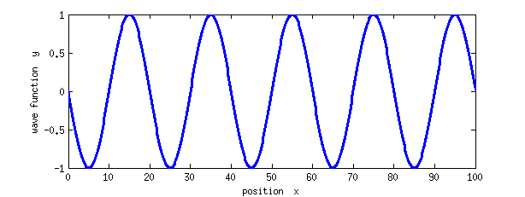
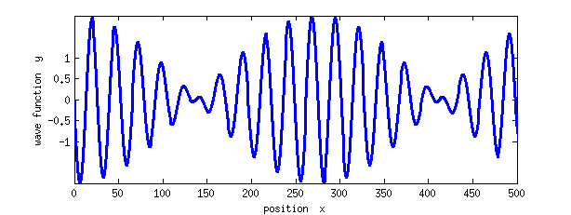
Waves and Fourier Expansion
A single travelling sine wave.
An example of beats by adding two sine waves.

Slide 2
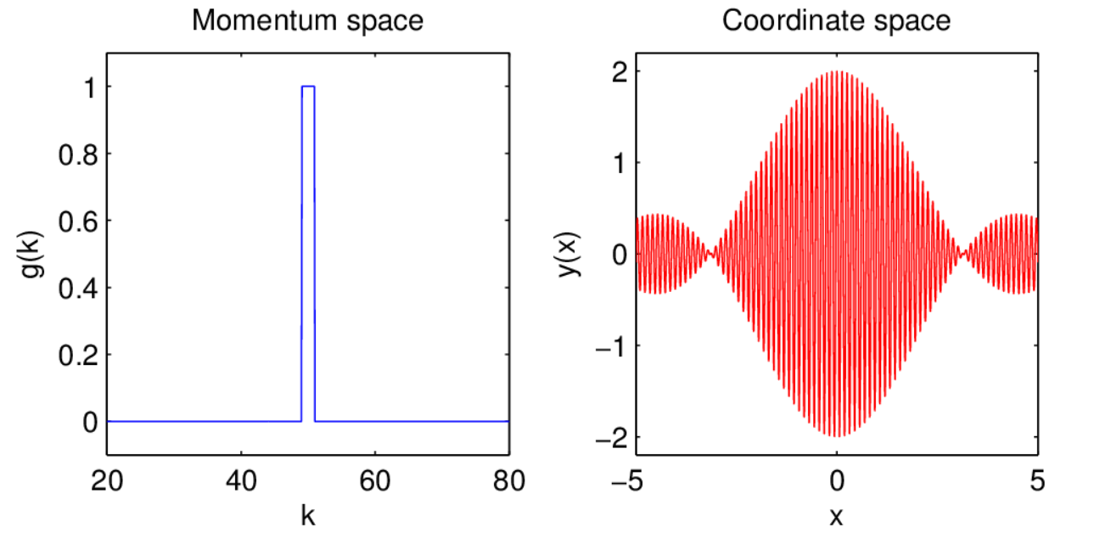
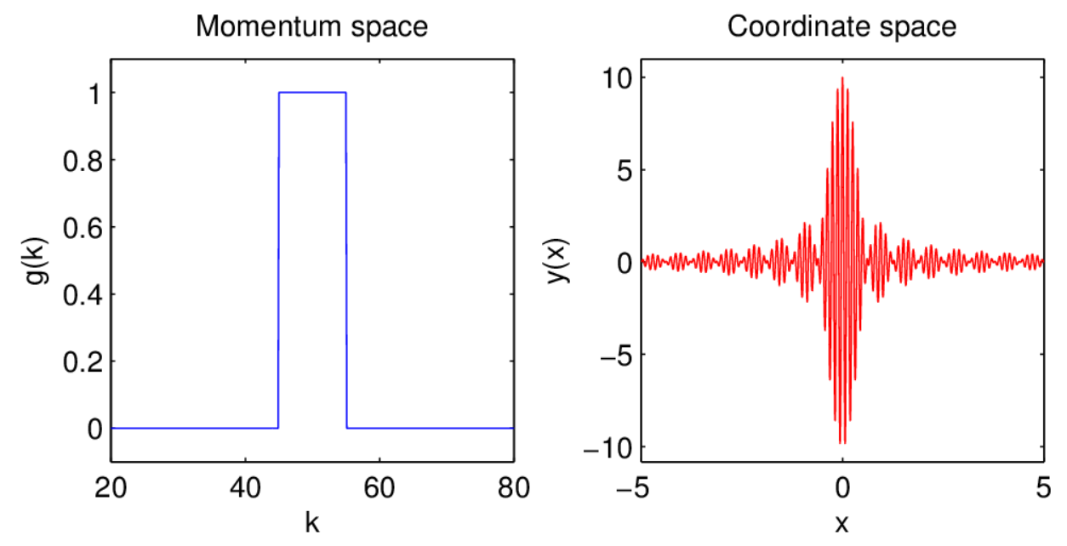
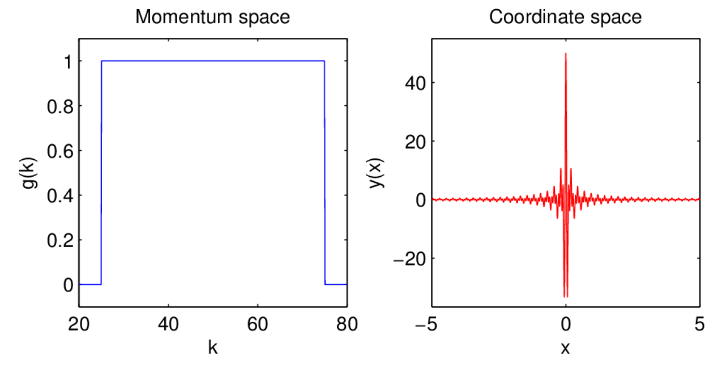
$$Δk=2$$
$$k_{0}=50$$
$$Δk=10$$
$$y\left(x\right)=A sinc \left(\frac{Δkx}{2}\right)cos⁡(k_{0}x)$$
$$∆x∆k>\frac{1}{2}$$
$$Δk=50$$

Slide 3
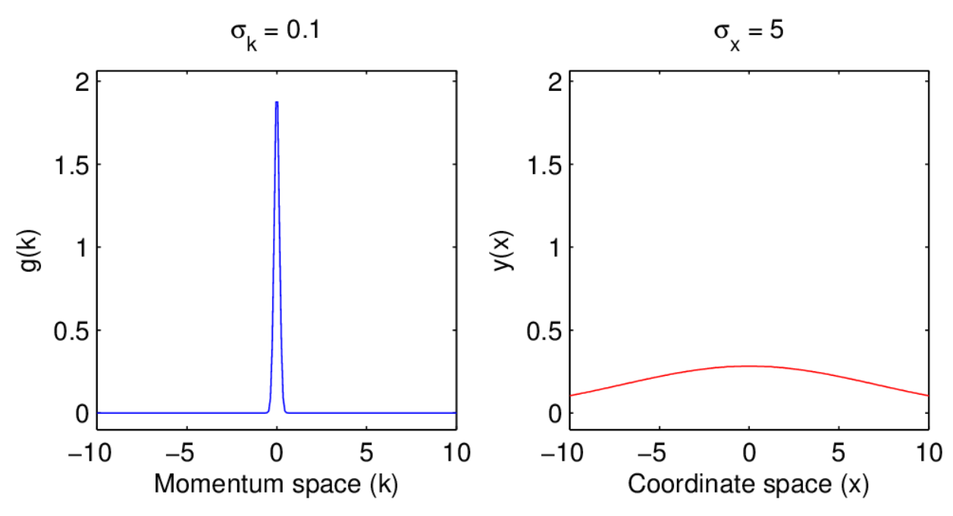
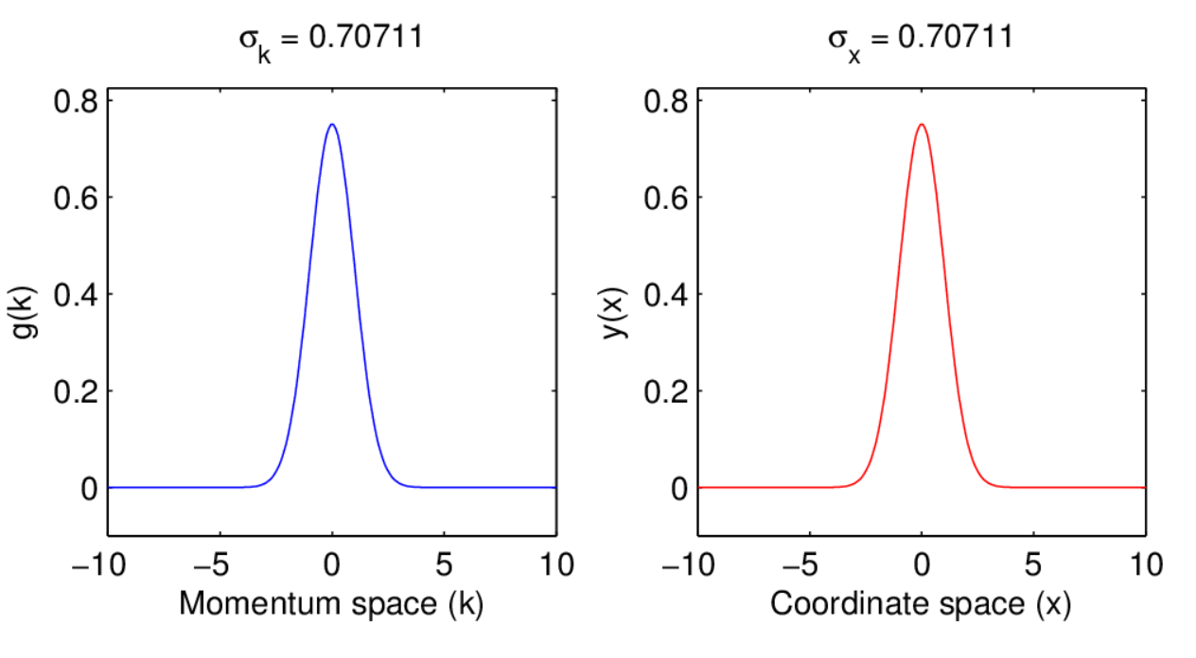
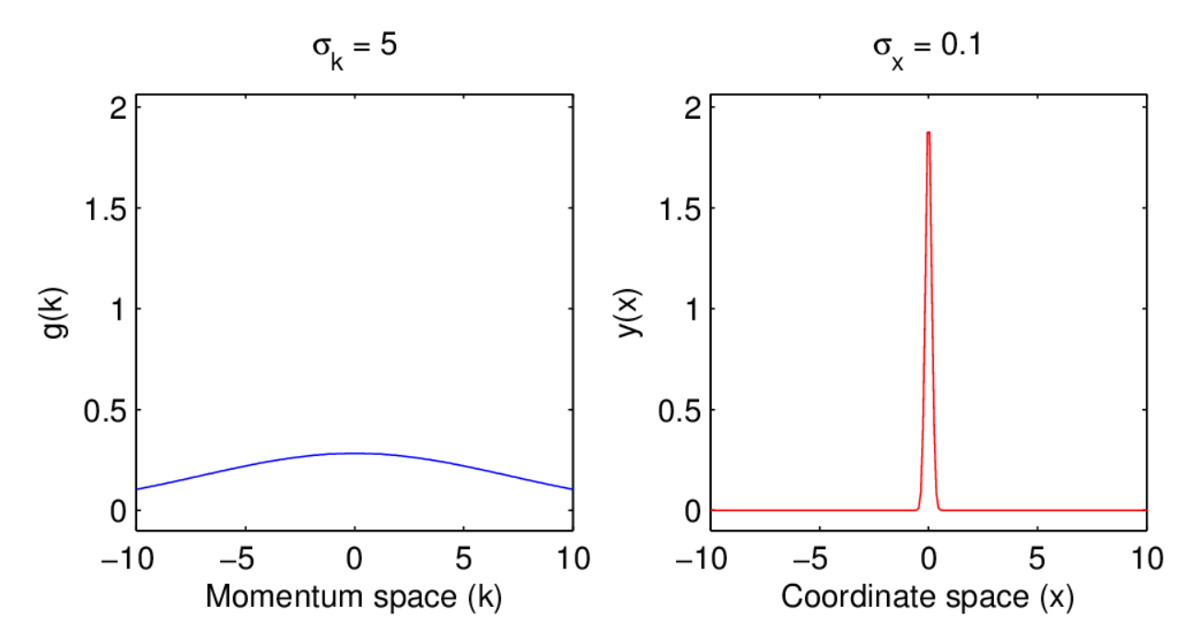
The Fourier transform of a Gaussian is another Gaussian…
$$g\left(k\right)=\frac{1}{\sqrt{2 π}{ σ}_{k}}exp⁡(\frac{−k2}{2 σk2})$$
$$y\left(x\right)=\frac{1}{\sqrt{2 π}{ σ}_{x}}exp⁡(\frac{−x2}{2 σx2})$$
$$σ_{x}σ_{k}= \frac{1}{2}$$
$$∆x∆k>\frac{1}{2}$$

Slide 4
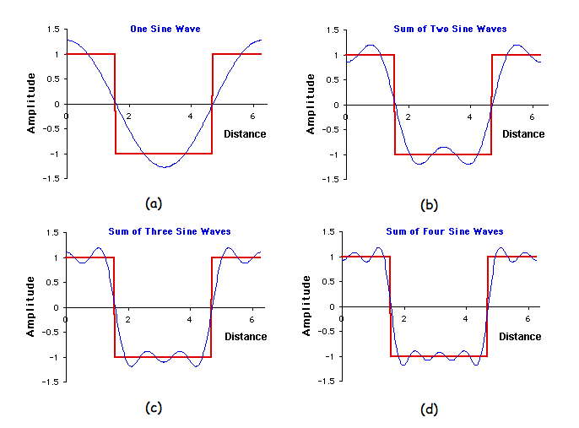

Slide 5
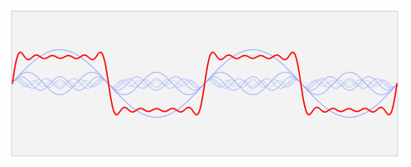

Slide 6
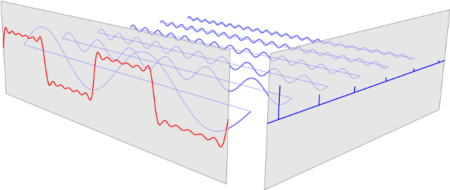
Coordinate space (x)
Momentum/wave space (k)

Slide 7
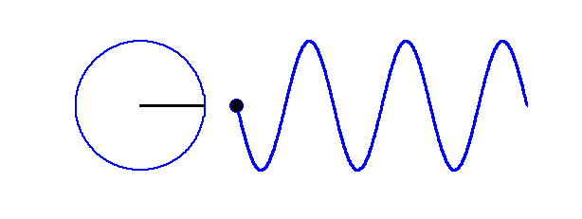
Im
Re
$$\exp\left(iθ\right)=\cos\left(θ\right)+i sin⁡(θ)$$

Slide 8
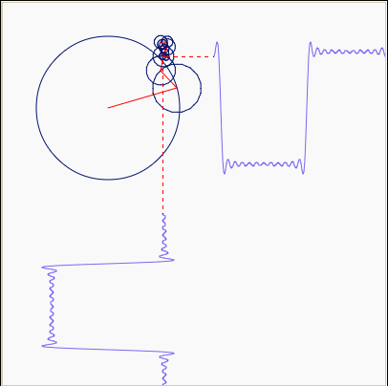

Slide 9
Copenhagen Interpretation of Quantum Mechanics
1.) A wave function represents the state of a system. It contains all information about anything that can be known about a system before an observation. The wavefunction evolves smoothly in time.
2.) Certain properties cannot be known simultaneously for a given system (Heisenberg’s Uncertainty Principle). Momentum is meaningless for a perfectly localized particle.
3.) During an observation, the system must interact with a laboratory device. When that device makes a measurement, the wavefunction of the system collapses. Collapse of the wavefunction means a wavefunction irreversibly reduces to an eigenfunction corresponding to a particular eigenvalue.
4.) The results provided by measuring devices are classical, and must be stated in classical terms.
5.) The Born rule: Wavefunctions give a probabilistic description of an experimental outcome.
6.) Complementarity rule (Bohr): The wavefunction demonstrates a fundamental wave-particle duality that is a necessary feature of nature.
7.) Correspondence rule (Bohr and Heisenberg): When quantum numbers are large, the behaviour of a system reproduces classical predictions.

Slide 10
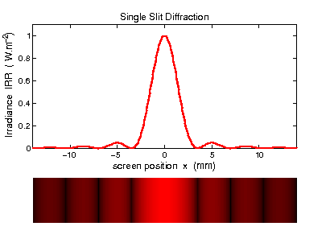
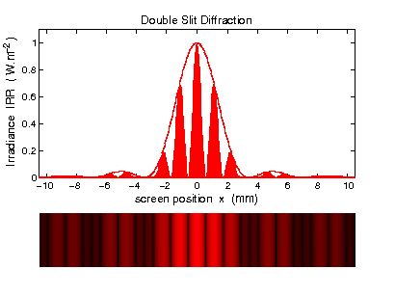
The double-slit experiment for particles

Slide 11
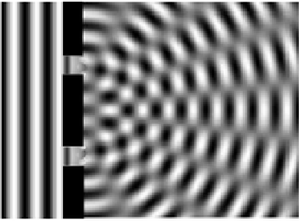

Slide 12
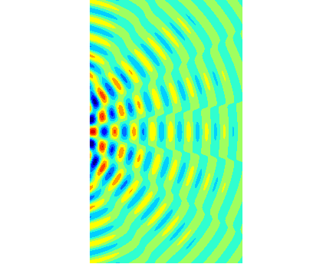

Slide 13
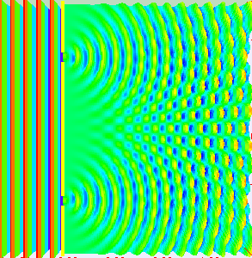

Slide 14
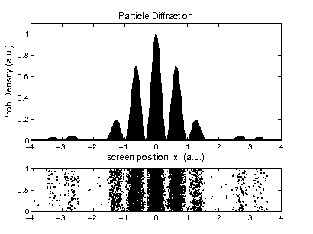

Slide 15
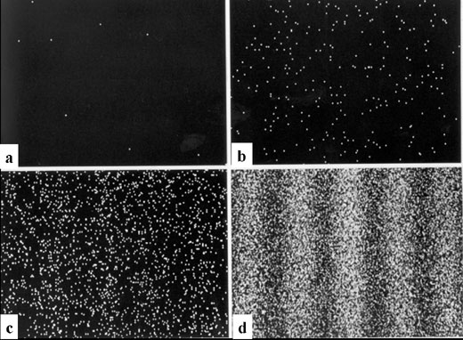
Single electron diffraction pattern (20 minutes duration)
a) 8 electrons c) 2000 electrons
b) 270 electrons d) 160,000 electrons

Slide 16
