Slide 1
Hydrogen atom – Angular part
Spherical harmonics:
The quantum numbers n, l, m determine the complete 3D behaviour of the wavefunction. The quantum numbers are the principle (n), orbital (l) and magnetic (m) numbers that are known from Chemistry. The l and m quantum numbers are related to angular momentum.

Slide 2
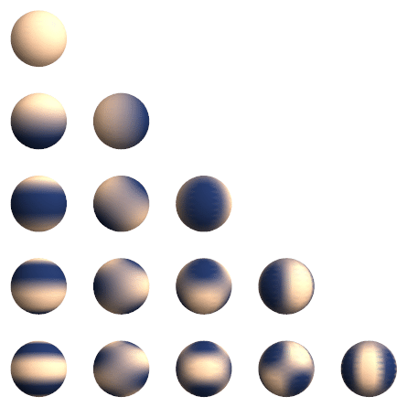
s-type orbital
l=0
Spherical harmonics – normal plots
p-type orbital
l=1
d-type orbital
l=2
f-type orbital
l=3
l=4
m=0
m=1
m=2
m=3
m=4

Slide 3
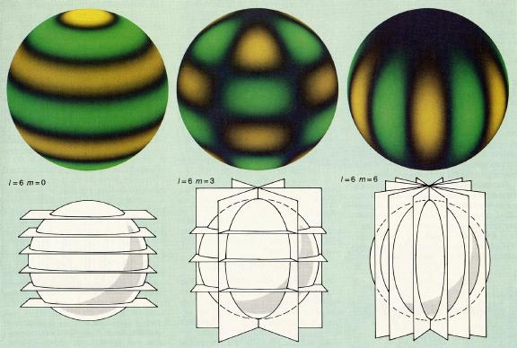
The probability densities in r and $θ$ have zeros for several values. These result in nodal surfaces where the probability of finding the electron vanishes. This is because bound particles are standing waves!
All eigenstates (except for the ground state) are degenerate in energy since the energy only depends on n.
Now let’s investigate the spherical harmonics using polar plots. In these plots, the distance from origin to curve in direction $θ$ is given by Y_{l,m}($θ$,$φ$). 3D dependence from rotating around z-axis (ie, through all $φ$).

Slide 4
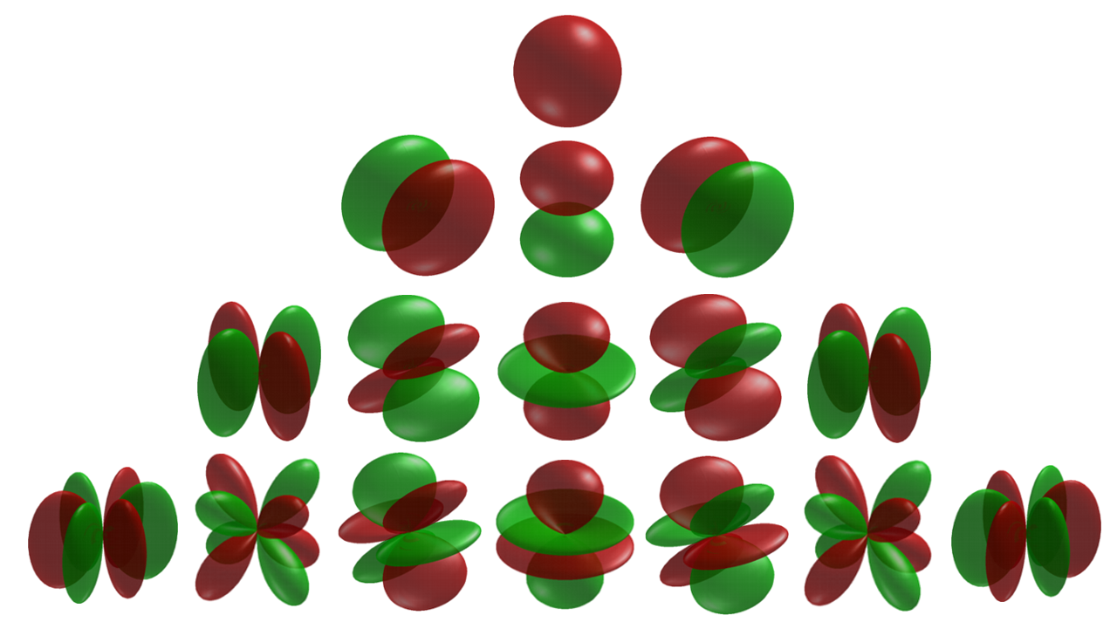
Spherical harmonics – polar plots
l=0, m=0
l=1, m=-1,0,1
l=2, m=-2,-1,0,1,2
l=3, m=-3,-2,-1,0,1,2,3

Slide 5
Hydrogen atom – Radial part

Slide 6
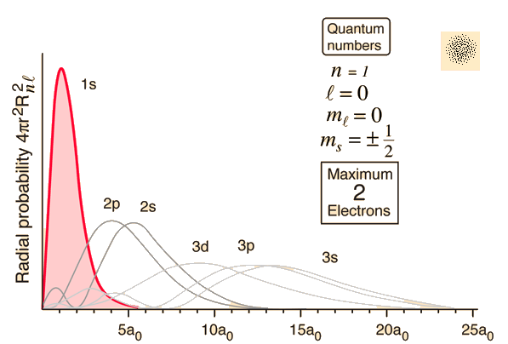

Slide 7
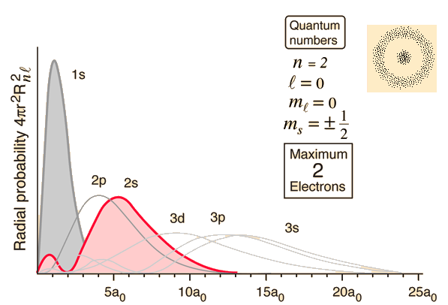

Slide 8
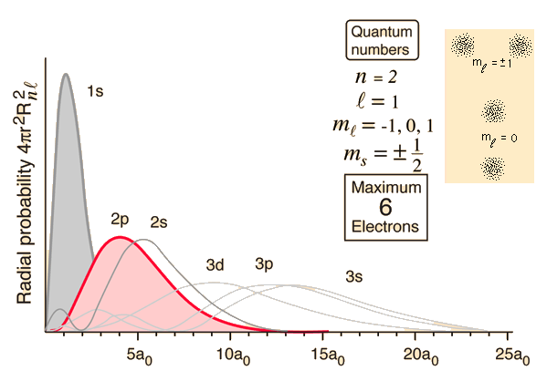

Slide 9
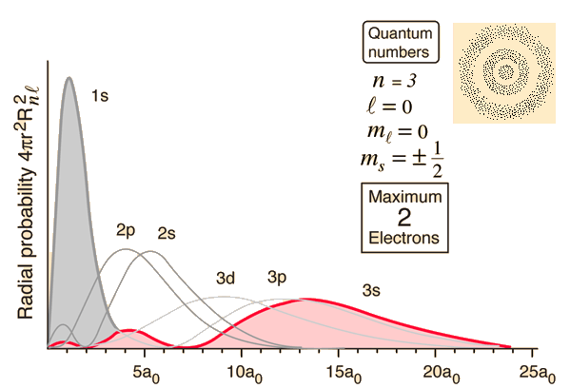

Slide 10
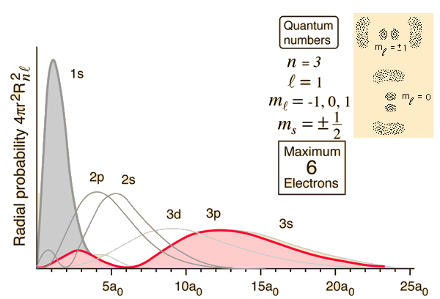

Slide 11
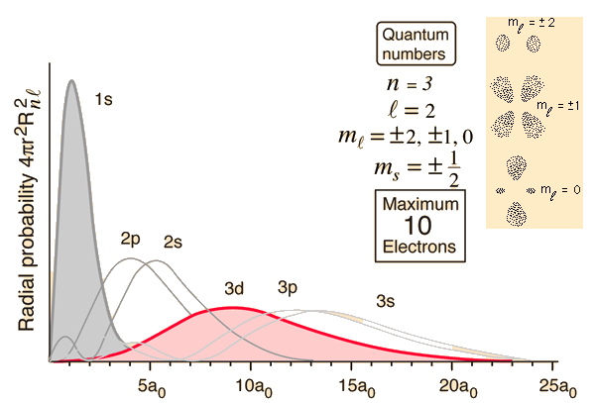

Slide 12
The Hydrogen atom wavefunction:
Born’s rule: Probability of finding the particle within some volume:

