Slide 1
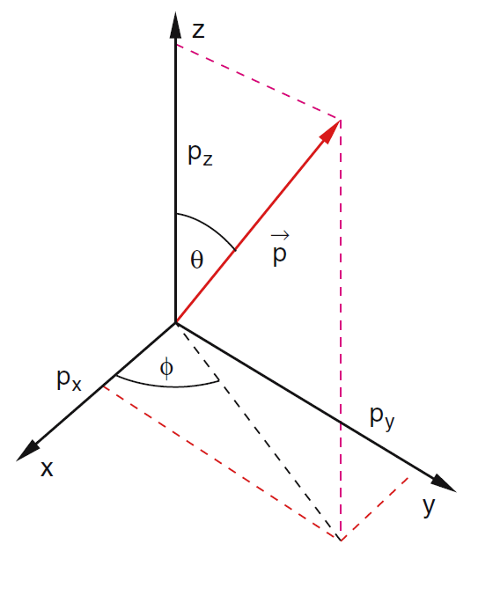
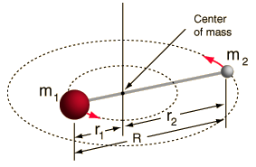
Diatomic molecules
L
L
L
When we treat the free rotor as two masses at a fixed distance, we find the energy is dependent on the orbital quantum number:
L
$E_{ROT}=$ $\frac{ℏ^{2}l(l+1)}{2I}$

Slide 2
Molecules can absorb and emit electromagnetic radiation in a similar fashion to atoms.
When a molecule absorbs a photon, it’s electrons become excited and jump to higher energy levels.
When a molecule emits a photon, it’s electrons lose energy and drop back down to lower levels.
This is similar to the behaviour of individual atoms. Molecules also have electron transition energies that are on the order of electron volts (eV). Recall the ionization energy of hydrogen is 13.6 eV.
Electric field
Magnetic field
However, molecules are more complicated than individual atoms. On much lower energy scales, diatomic molecules can change their rotational state (angular momentum) and their vibrational state as well as their electronic state.
The energies of these transitions are much lower (1/100 and 1/1000 eV)

Slide 3
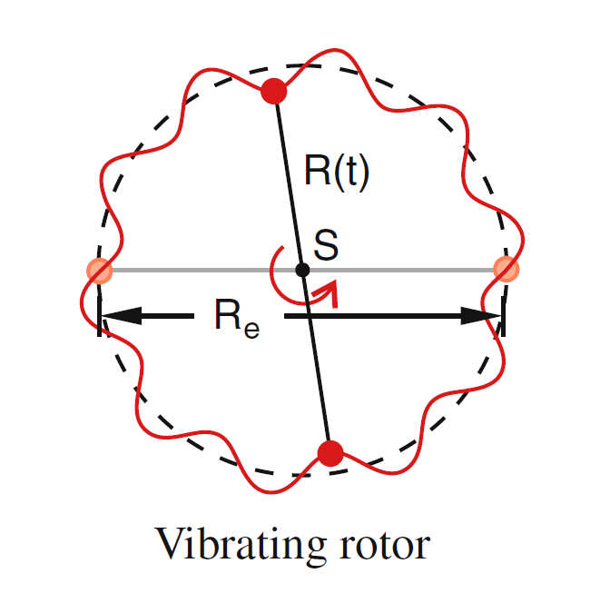
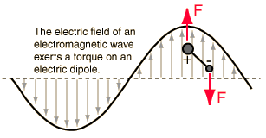
A molecule can change its rotational state (quantum number l) only if it has a permanent electric dipole moment (asymmetric molecules). If it does not have a permanent dipole moment, both the vibrational and rotational state of the molecule must change simultaneously. Their spectrum will show this.
Last class we discussed the behaviour of a molecule in terms of its angular momentum, which gave the rotational energy in terms of the orbital quantum number.
We briefly discussed vibrational state, using a simple harmonic oscillator to describe the motion of the component atoms. Today we will discuss the effect this has on the energy of the system and leave more detailed treatment of the wave functions for another time.
Symmetric molecule with dipole moment

Slide 4
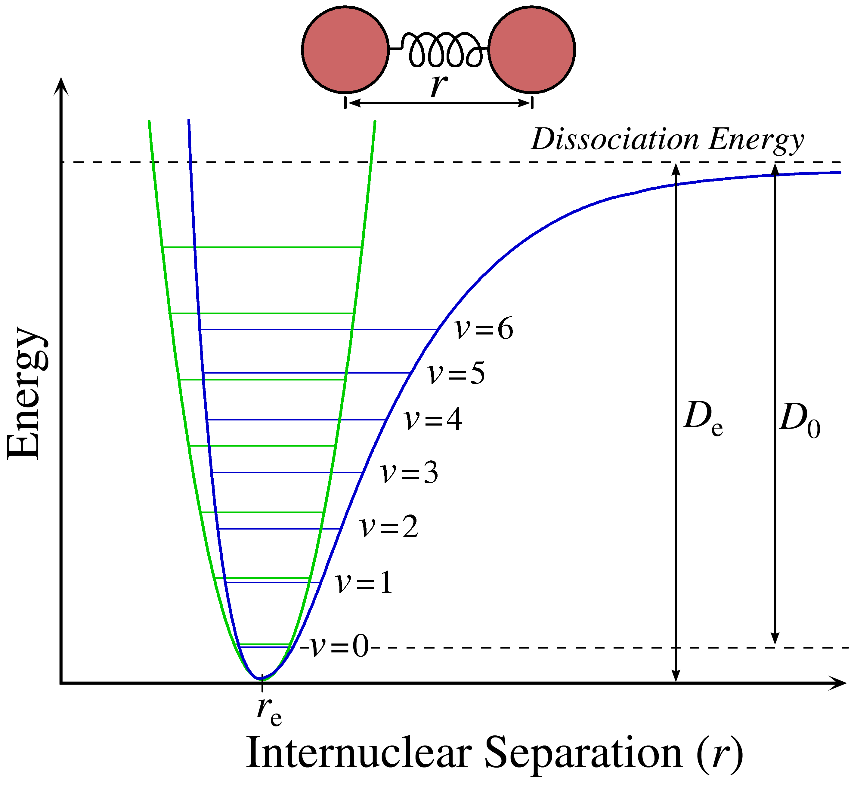
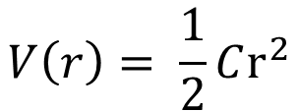
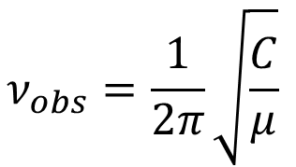
When we allow the molecule to vibrate in addition to rotate, r is no longer constant. We use a simple harmonic oscillator potential to describe the interaction of the two masses.
To first order the masses behave as though they are connected by a spring and exert a force on one another described by Hooke’s law.
$$n_{ν}$$
$$V\left(r\right)= \frac{1}{2}Cr^{2}$$
$$n_{ν}$$
$$n_{ν}$$
$$n_{ν}$$
Recall the energy levels of the quantum SHO:
$$n_{ν}$$
$$ν_{obs}=\frac{1}{2π}\sqrt{\frac{C}{μ}}$$
$$E_{SHO}=\left(n_{ν}+\frac{1}{2}\right)ℏω$$
$$n_{ν}$$
$$n_{ν}$$
The Schrodinger equation splits into three parts – similar to the hydrogen atom – to describe motion in each of the three coordinate directions.

Slide 5
The main difference between the wave functions for the diatomic molecule and the hydrogen atom is that the radial and angular parts are not coupled as they are with the hydrogen atom.
With the Coulomb potential, the energy of the hydrogen atom is given entirely by the principle quantum number n and is degenerate in both l and m.
This is not the case with the diatomic molecule, which splits cleanly into rotational and angular parts.
The coupling of the equations is due to the details of the potential (SHO for the diatomic molecule vs. Coulomb for H-atom).
$$V_{COULOMB}\left(r\right)=−\frac{Ze^2}{4πε_{0}r}$$
$$V_{SHO}\left(r\right)= \frac{1}{2}Cr^{2}$$

Slide 6
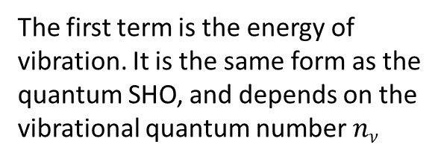
The result we’re most interested in is the energy, which has contributions from both vibration and rotational modes.
$$E=E_{SHO}+E_{ROT}$$
$$E=\left(n_{ν}+ \frac{1}{2}\right)ℏω+ \frac{ℏ^{2}}{2I}l(l+1)$$
The first term is the energy of vibration. It is the same form as the quantum SHO, and depends on the vibrational quantum number $nν$
The second term is the energy of rotation. It depends on the orbital angular momentum quantum number l.

Slide 7
$$E=\left(n_{ν}+ \frac{1}{2}\right)ℏω+ \frac{ℏ^{2}}{2I}l(l+1)$$
Increasing the energy of the diatomic molecule requires the molecule to absorb electromagnetic radiation – photons – which increases both it’s vibrational and orbital motion.
The most general way to write the change in energy is
$ΔE=\left[\left(n_{ν}^{′}+\frac{1}{2} \right)−\left(n_{ν}+\frac{1}{2}\right)\right]ℏω+ \frac{ℏ^{2}}{2I}[l′\left(l^{′}+1\right)−l(l+1)$]
Where $n_{ν}^{′}$ is the final vibrational state, $n_{ν}$ is the initial vibrational state, $l^{′}$is the final rotational state and $l$ is the initial rotational state.

Slide 8
For symmetric molecules with no permanent electric dipole moment, the absorption or emission of a photon requires both of the quantum numbers to change:
$$Δn_{ν}=±1$$
$$Δl= ±1$$
Where + stands for absorption (increase in the energy/angular momentum of a molecule) and – stands for emission of a photon (the molecule loses the energy/angular momentum of the emitted photon)
$ΔE=\left[\left(n_{ν}^{′}+\frac{1}{2} \right)−\left(n_{ν}+\frac{1}{2}\right)\right]ℏω+ \frac{ℏ^{2}}{2I}[l′\left(l^{′}+1\right)−l(l+1)$]
We can simplify this term a little bit
$l^{′}\left(l^{′}+1\right)−l\left(l+1\right)=l^{′2}+l^{′}−l^{2}−l$
$$Δl= ±1$$
means that l must change by 1 unit of angular momentum, so we must have:
$$l^{′}=l±1$$
$$l^{′2}={\left(l±1\right)}^{2}=l^{2}±2l+1$$
This gives us
$l^{′}\left(l^{′}+1\right)−l\left(l+1\right)$ =$±2l±1+1$

Slide 9
Along with , we have:
$$Δn_{ν}=±1$$
$ΔE=ℏω+ \frac{ℏ^{2}}{2I}[±2l±1+1$]
This means we have two solutions:
If $Δl=+1$ : $[l′\left(l^{′}+1\right)−l(l+1)$]$=2l+2=2(l+1)$
Then the change in energy is:
$ΔE_{+1}=ℏω+ \frac{ℏ^{2}}{I}\left(l+1\right)$
If $Δl=−1$ : $[l′\left(l^{′}+1\right)−l(l+1)$]$=−2l$
$$ΔE_{−1}=ℏω− \frac{ℏ^{2}}{I}l$$
Then the change in energy is:
Lines within both of these sets are separated by $\frac{ℏ^{2}}{I}$

Slide 10
From this, we predict a spectrum that looks like:
$$\frac{ℏ^{2}}{I}$$
$$\frac{ℏ^{2}}{I}$$
$$ℏω−3 \frac{ℏ^{2}}{I}$$
$$ℏω−2\frac{ℏ^{2}}{I}$$
$$ℏω−\frac{ℏ^{2}}{I}$$
$$ℏω+ \frac{ℏ^{2}}{I}$$
$$ℏω+2\frac{ℏ^{2}}{I}$$
$$ℏω+3\frac{ℏ^{2}}{I}$$
$$ΔE_{−1}=ℏω− \frac{ℏ^{2}}{I}l$$
$ΔE_{+1}=ℏω+ \frac{ℏ^{2}}{I}\left(l+1\right)$
$$ℏω$$
$$Δl=−1$$
$$Δl= +1$$
Let’s compare this to real data. What does a spectrum of a diatomic molecule look like in the lab? Consider, for example, hydrogen chloride (HCl)…

Slide 11
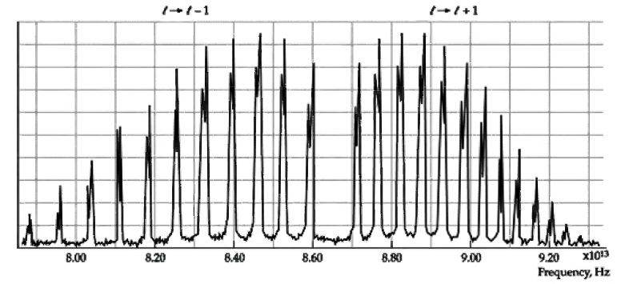
$$ℏω$$
$$ℏω−3 \frac{ℏ^{2}}{I}$$
$$ℏω−2\frac{ℏ^{2}}{I}$$
$$ℏω−\frac{ℏ^{2}}{I}$$
$$ℏω+ \frac{ℏ^{2}}{I}$$
$$ℏω+2\frac{ℏ^{2}}{I}$$
$$ℏω+3\frac{ℏ^{2}}{I}$$
Actual spectrum of HCl molecule in microwave frequency band
Spectral peaks are split due to 2 mass isotopes of Chlorine, Cl-35 (75%) and Cl-37 (25%)
$$\frac{ℏ^{2}}{I}$$
$$\frac{ℏ^{2}}{I}$$
$$Δl=−1$$
$$Δl= +1$$

Slide 12
A number of other features show up in spectra like this one:
Note that the lines aren’t evenly spaced as we predicted they would be!
We assumed the moment of inertia is constant, but this isn’t quite true. As the molecule rotates, it stretches out a bit and this decreases the rotational energy, especially for large l!
The shape of the spectrum changes. Why are some lines more intense than others?
The population of an orbital level depends on the degeneracy (2l+1), and an exponential factor:
$$N\left(E\right)=\left(2l+1\right)e^{−\frac{E}{k_{b}T}}$$

Slide 13
$$l=3$$
$$l=2$$
$$n_{ν}=1$$
$$l=1$$
$$l=0$$
Rotational-vibrational transitions in HCl
$$l=3$$
$$l=2$$
$$n_{ν}=0$$
$$l=1$$
$$l=0$$
$$Δl=−1$$
$$Δl= +1$$

Slide 14
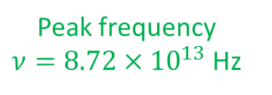
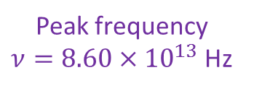
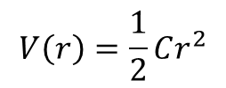
$$V\left(r\right)=\frac{1}{2}Cr^{2}$$
$$2$$
$$1$$
$$l=0$$
$$n_{ν}=1$$
$$3$$
$$2$$
$$1$$
$$l=0$$
$$n_{ν}=0$$
Peak frequency
$ν=8.60×{10}^{13}$ Hz
$$n_{ν}=0→1$$
$$n_{ν}=0→1$$
Peak frequency
$ν=8.72×{10}^{13}$ Hz
$$l=1→0$$
$$l=0→1$$
Center frequency for $n_{ν}=0→n_{ν}=1$
Frequency: $ν=8.66×{10}^{13}$ Hz

Slide 15
See Section 9.4 for more details on diatomic molecules
This term we also studied
Chapter 6: The Schrodinger Equation
Chapter 7:
7.1 : Schrodinger equation in 3D
7.2 : Angular momentum (Questions)
7.3 : The hydrogen atom

